Slide 1
Lecture 24: Review

Slide 2
Uncertainty in model and prediction
Cross validation
Overfitting: Variance & Bias
Pandas
NumPy
Scikit-Learn
PCA & dimensionality reduction
Statistical Learning
Computing Tools
Matplotlib
Methods of regularization:
Lasso and Ridge
Regression
Classification
Logistic
Linear
Trees
KNN
Neural Networks
Experimental Design & Causal Inference

Slide 3
Uncertainty in model and prediction
Cross validation
Overfitting: Variance & Bias
Pandas
NumPy
Scikit-Learn
PCA & dimensionality reduction
Statistical Learning
Computing Tools
Matplotlib
Methods of regularization:
Lasso and Ridge
Regression
Classification
Logistic
Linear
Trees
KNN
Neural Networks
Experimental Design & Causal Inference

Slide 4
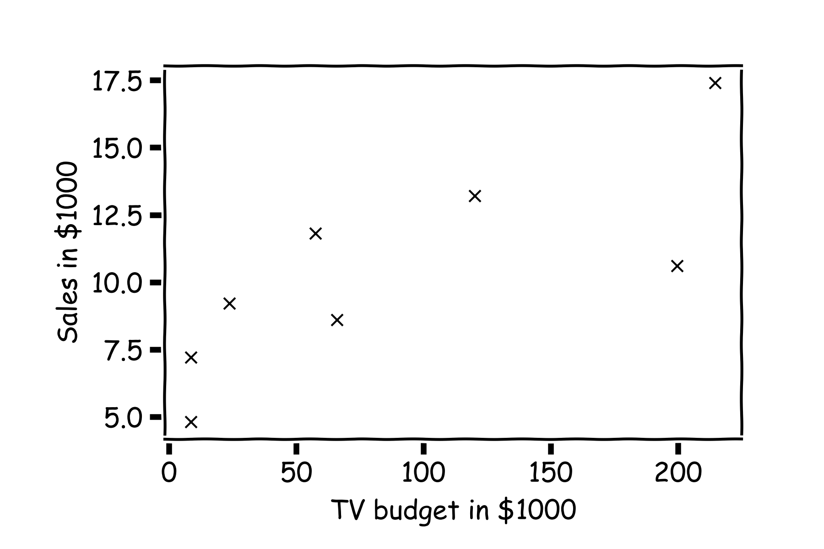
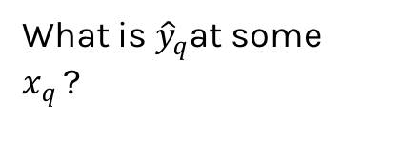
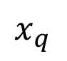
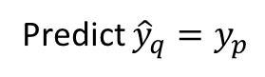
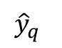
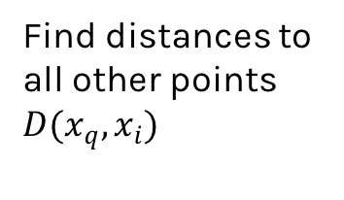
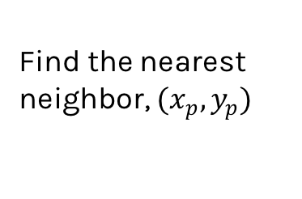
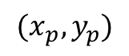
Simple Prediction Model
What is ${\hat{y}}_{q}$at some $x_{q }$?
Find distances to all other points $D(x_{q},x_{i})$
$${(x}_{p},y_{p})$$
$${\hat{y}}_{q}$$
Find the nearest neighbor, ${(x}_{p},y_{p})$
Predict ${\hat{y}}_{q}=y_{p}$
$$x_{q}$$
Notes:
Is it clear that x_q is really x_i,q? (DLS)

Slide 5
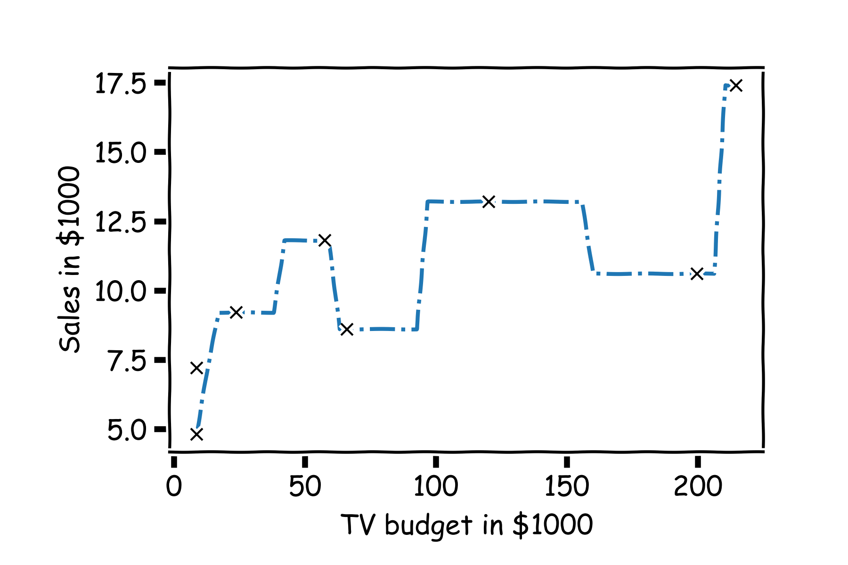
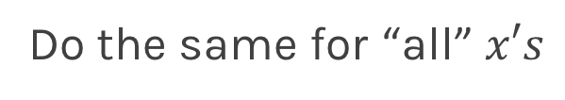
Simple Prediction Model
Do the same for “all” $x′s$

Slide 6
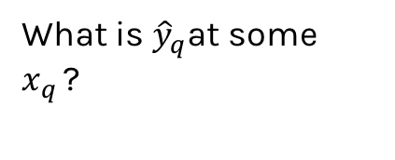
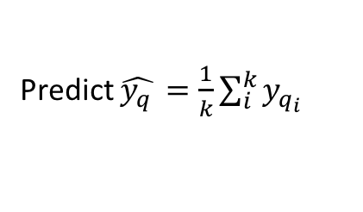
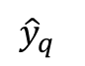
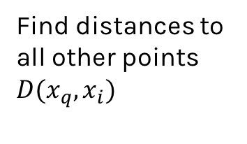
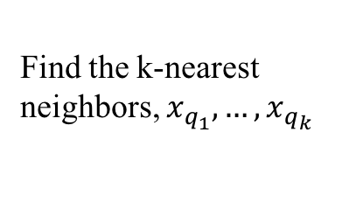
Extend the Prediction Model
What is ${\hat{y}}_{q}$at some $x_{q }$?
Find distances to all other points $D(x_{q},x_{i})$
$${\hat{y}}_{q}$$
Find the k-nearest neighbors, $x_{q_{1}},…,x_{q_{k}}$
Predict $\hat{y_{q }}=\frac{1}{k}\sum_{i}^{k}{y_{q_{i}}}$
$$x_{q}$$
Notes:
Change indeces and show k-nearest

Slide 7
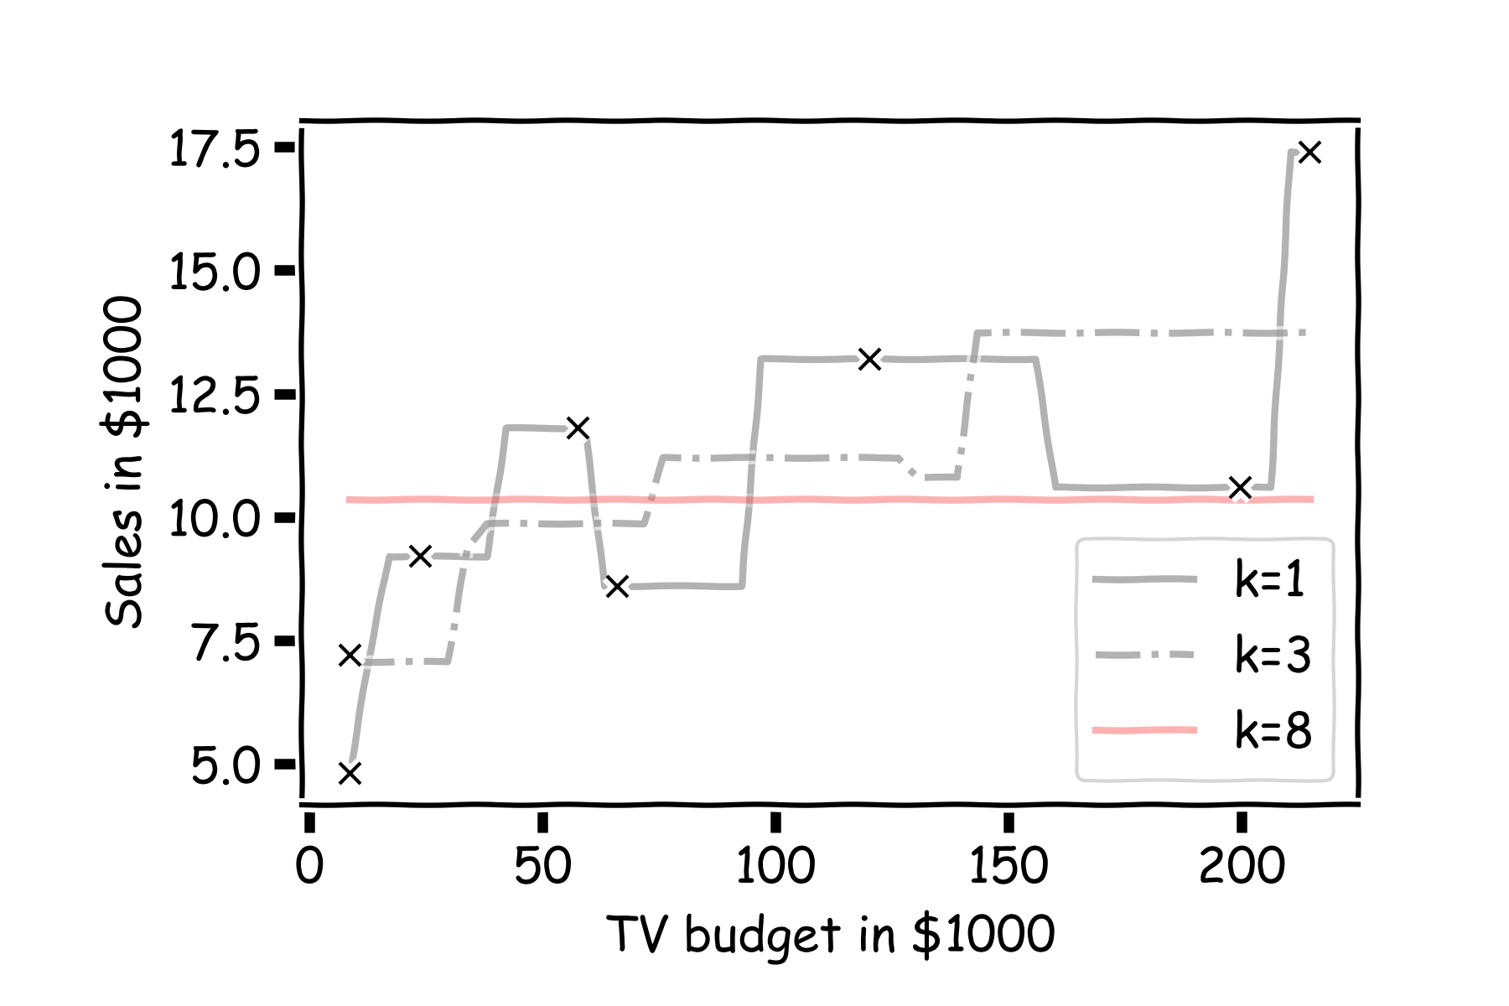
Simple Prediction Models
Notes:
Change indeces and show k-nearest

Slide 8

Simple Prediction Models
We can try different k-models on more data
Notes:
Change indeces and show k-nearest

Slide 9
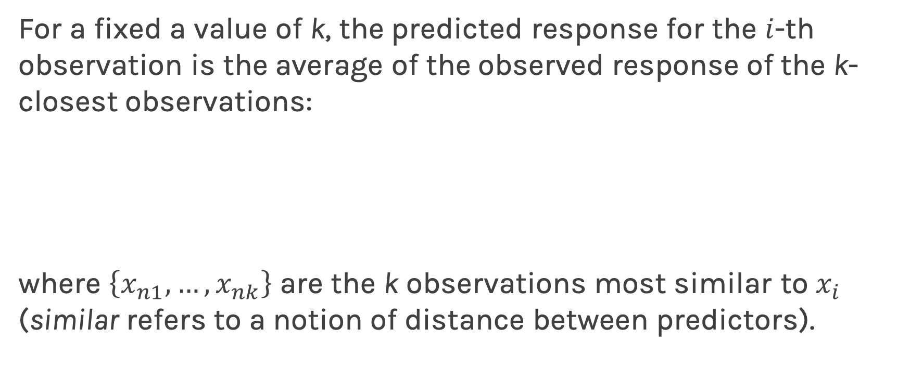
k-Nearest Neighbors - kNN
For a fixed a value of k, the predicted response for the $i$-th observation is the average of the observed response of the k-closest observations:
where $\left\{x_{n1},…,x_{nk}\right\}$ are the k observations most similar to $x_{i}$ (similar refers to a notion of distance between predictors).
Notes:
Notice y_hat instead of f_hat
I think the index on y_hat is wrong but I can’t change it b/c it’s an image. (DLS)

Slide 10
ED quiz: Lecture 4 | part 1
Notes:
Change indeces and show k-nearest

Slide 11
Uncertainty in model and prediction
Cross validation
Overfitting: Variance & Bias
Pandas
NumPy
Scikit-Learn
PCA & dimensionality reduction
Statistical Learning
Computing Tools
Matplotlib
Methods of regularization:
Lasso and Ridge
Regression
Classification
Logistic
Linear
Trees
KNN
Neural Networks
Experimental Design & Causal Inference

Slide 12
Uncertainty in model and prediction
Cross validation
Overfitting: Variance & Bias
Pandas
NumPy
Scikit-Learn
PCA & dimensionality reduction
Statistical Learning
Computing Tools
Matplotlib
Methods of regularization:
Lasso and Ridge
Regression
Classification
Logistic
Linear
Trees
KNN
Neural Networks
Experimental Design & Causal Inference

Slide 13
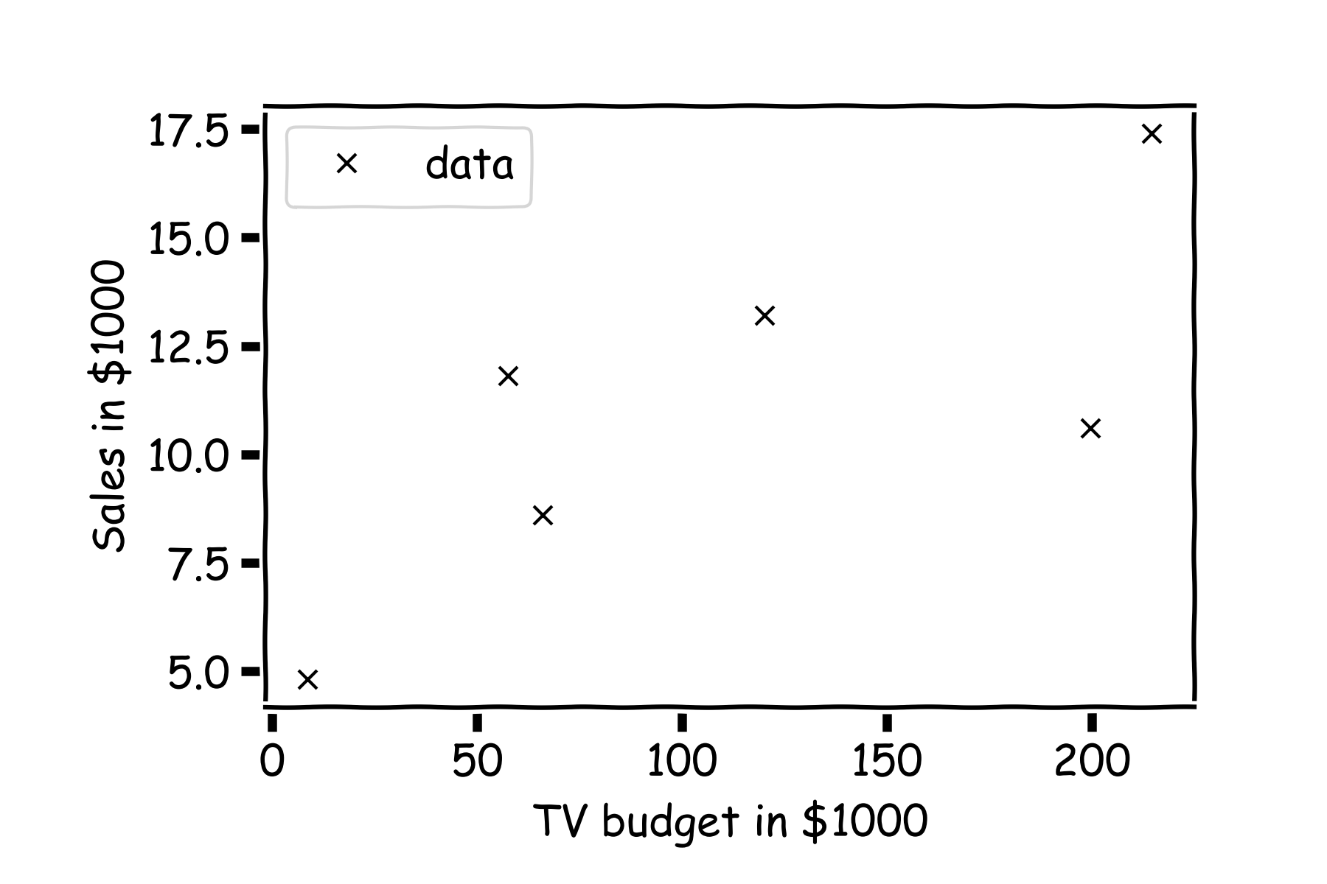
Estimate of the regression coefficients
For a given data set

Slide 14
Estimate of the regression coefficients (cont)
Is this line good?

Slide 15
Estimate of the regression coefficients (cont)
Maybe this one?

Slide 16
Estimate of the regression coefficients (cont)
Or this one?

Slide 17
Estimate of the regression coefficients (cont)
Question: Which line is the best?
First calculate the residuals

Slide 18
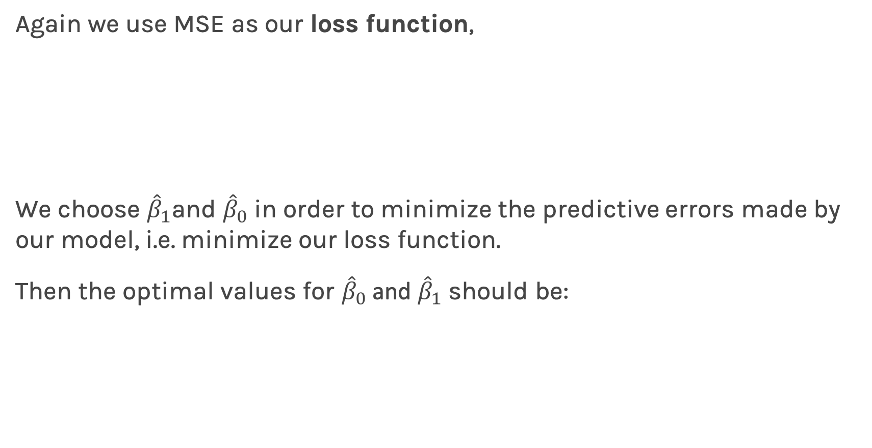
Estimate of the regression coefficients (cont)
Again we use MSE as our loss function,
We choose ${\hat{β}}_{1}$and ${\hat{β}}_{0}$ in order to minimize the predictive errors made by our model, i.e. minimize our loss function.
Then the optimal values for ${\hat{β}}_{0}$ and ${\hat{β}}_{1}$ should be:

Slide 19
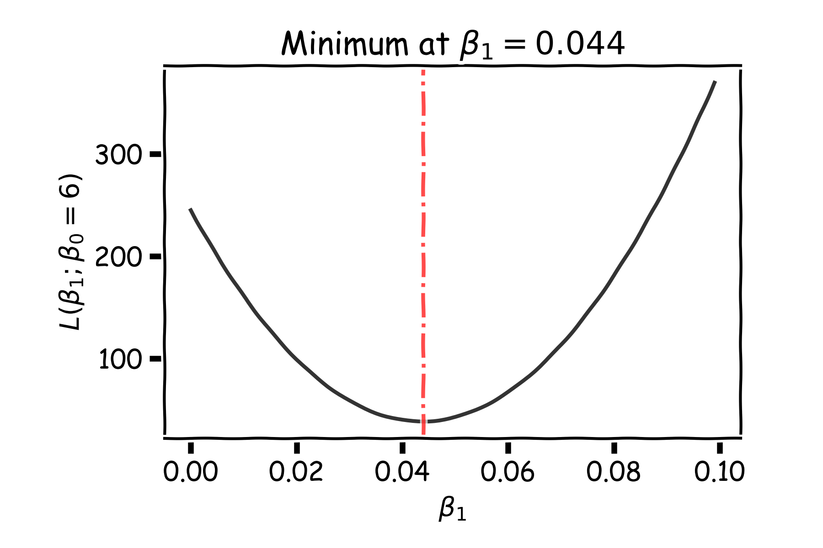
Estimate of the regression coefficients: brute force
A way to estimate ${argmin}_{β_{0},β_{1}}{L}$ is to calculate the loss function for every possible $β_{0}$ and $β_{1}$. Then select the $β_{0}$ and $β_{1}$ where the loss function is minimum.
E.g. the loss function for different $β_{1}$ when $β_{0}$is fixed to be 6:
Notes:
Shall I add a contour plot?

Slide 20
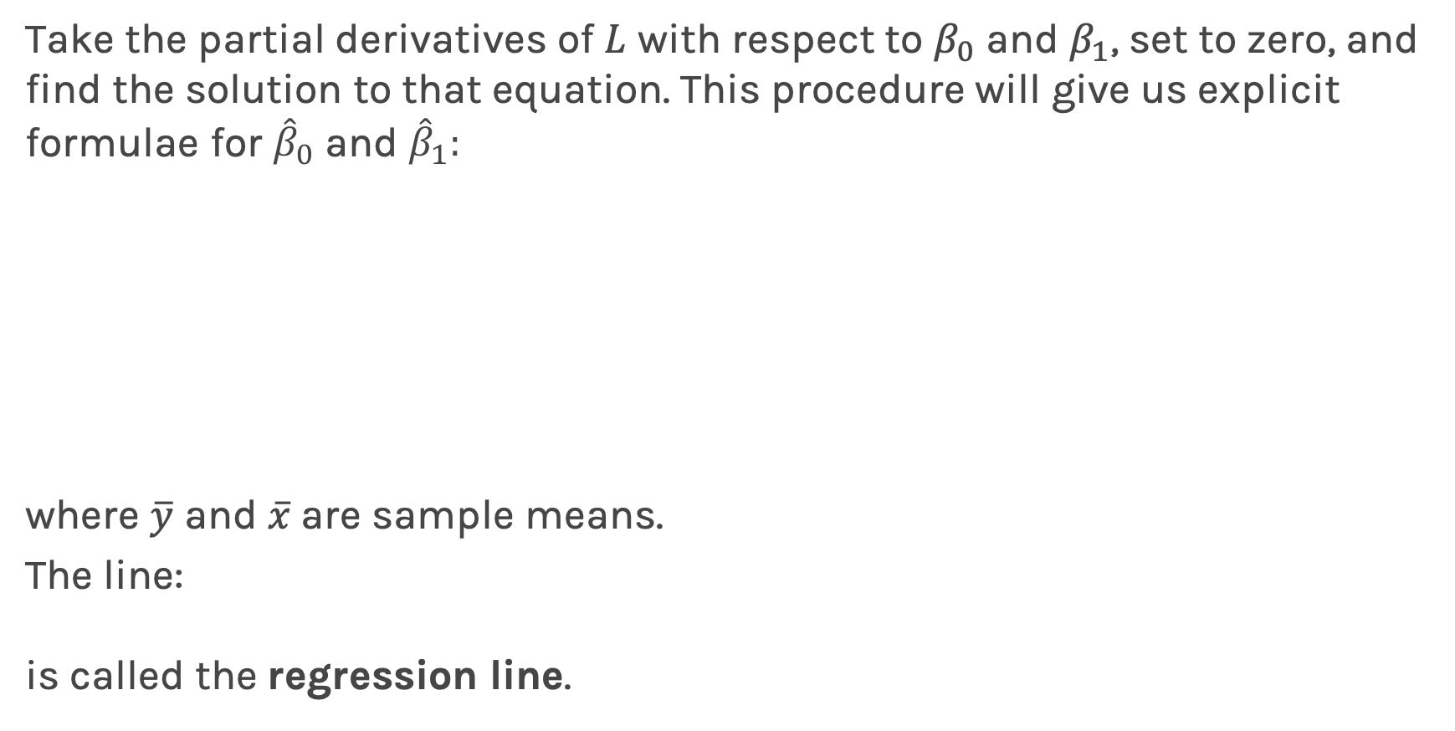
Estimate of the regression coefficients: exact method
Take the partial derivatives of $L$ with respect to $β_{0}$ and $β_{1}$, set to zero, and find the solution to that equation. This procedure will give us explicit formulae for ${\hat{β}}_{0}$ and ${\hat{β}}_{1}:$
where $\overline{y}$ and $\overline{x}$are sample means.
The line:
is called the regression line.

Slide 21
Uncertainty in model and prediction
Cross validation
Overfitting: Variance & Bias
Pandas
NumPy
Scikit-Learn
PCA & dimensionality reduction
Statistical Learning
Computing Tools
Matplotlib
Methods of regularization:
Lasso and Ridge
Regression
Classification
Logistic
Linear
Trees
KNN
Neural Networks
Experimental Design & Causal Inference

Slide 22
Uncertainty in model and prediction
Cross validation
Overfitting: Variance & Bias
Pandas
NumPy
Scikit-Learn
PCA & dimensionality reduction
Statistical Learning
Computing Tools
Matplotlib
Methods of regularization:
Lasso and Ridge
Regression
Classification
Logistic
Linear
Trees
KNN
Neural Networks
Experimental Design & Causal Inference

Slide 23
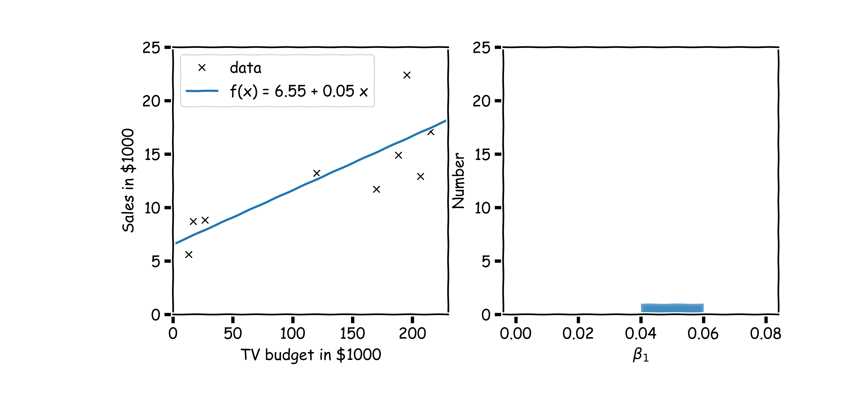
Confidence intervals for the predictors estimates (cont)
$$.$$
In our magical realisms, we can now sample multiple times

Slide 24
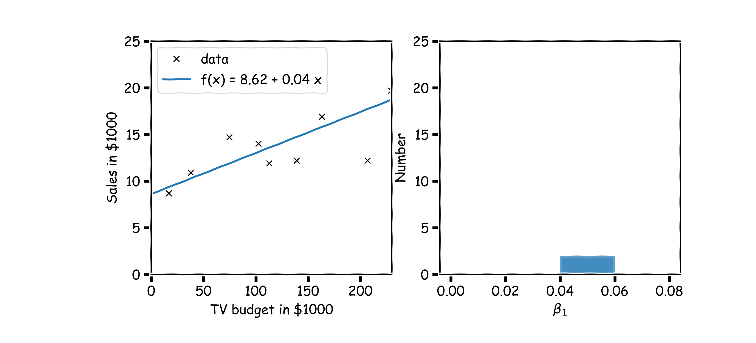
Confidence intervals for the predictors estimates (cont)
Another sample

Slide 25
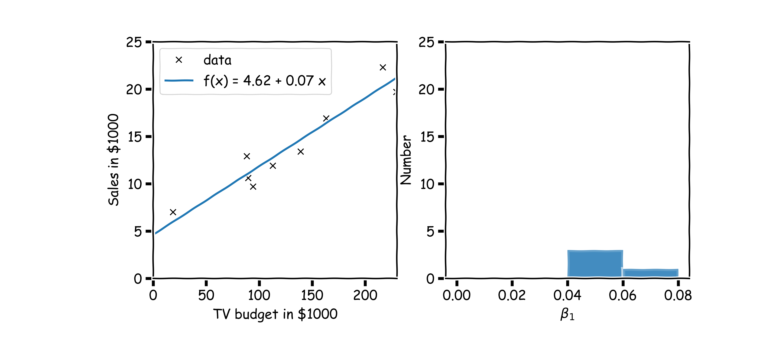
Confidence intervals for the predictors estimates (cont)
Another sample

Slide 26
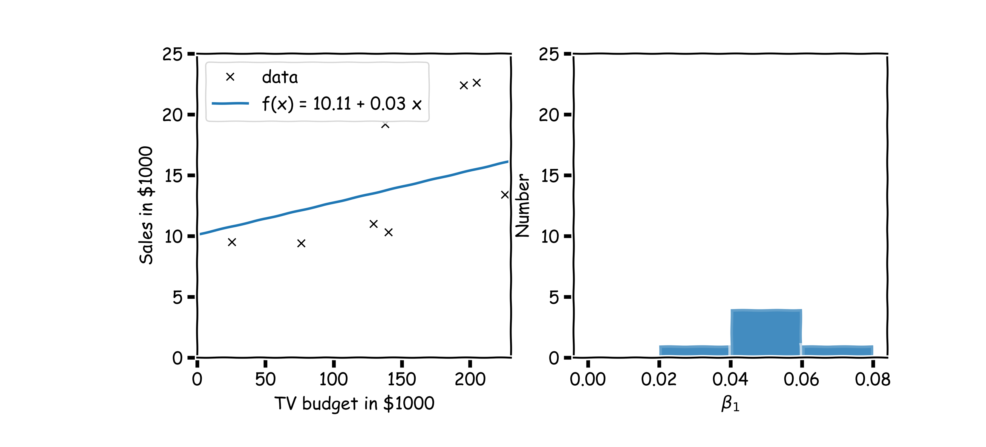
Confidence intervals for the predictors estimates (cont)
And another sample

Slide 27
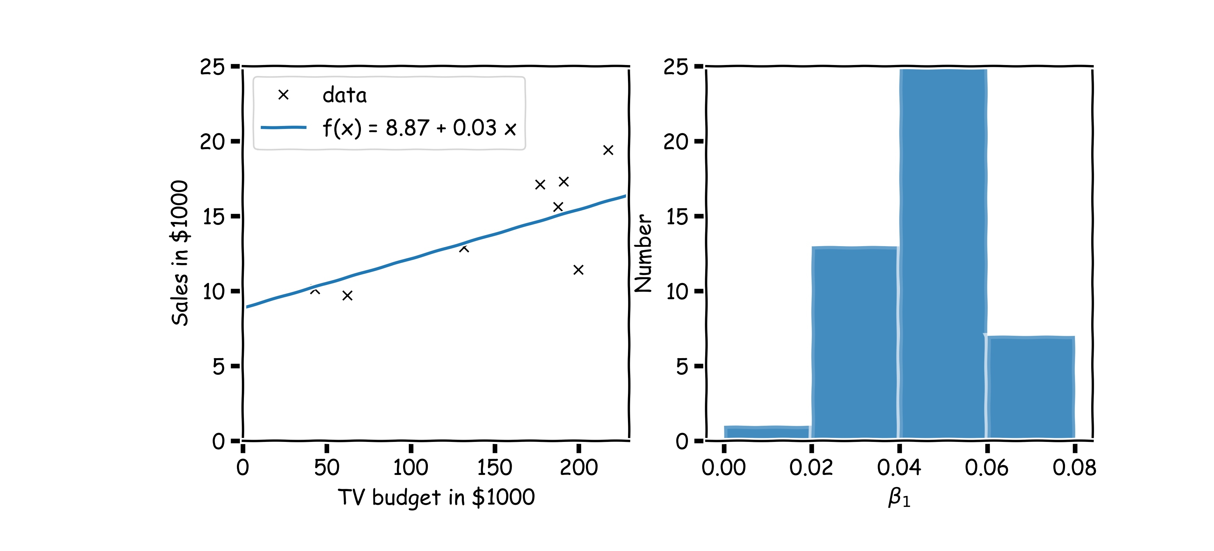
Confidence intervals for the predictors estimates (cont)
Repeat this for 100 times

Slide 28
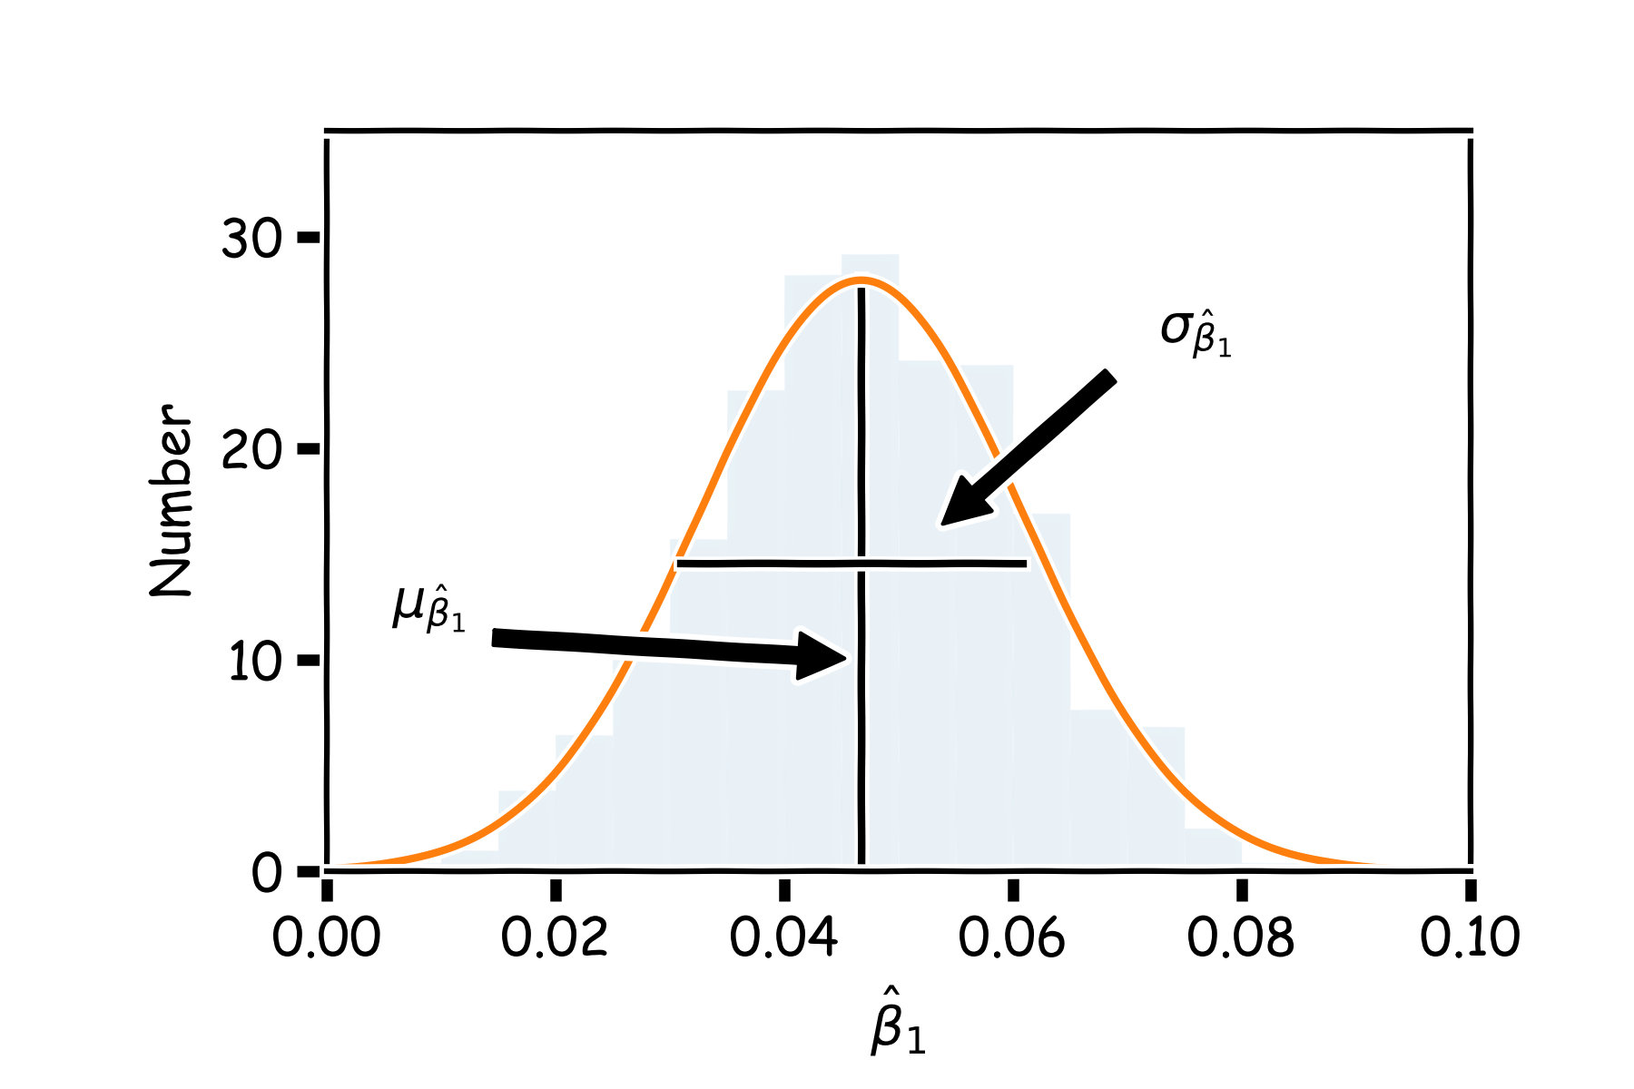
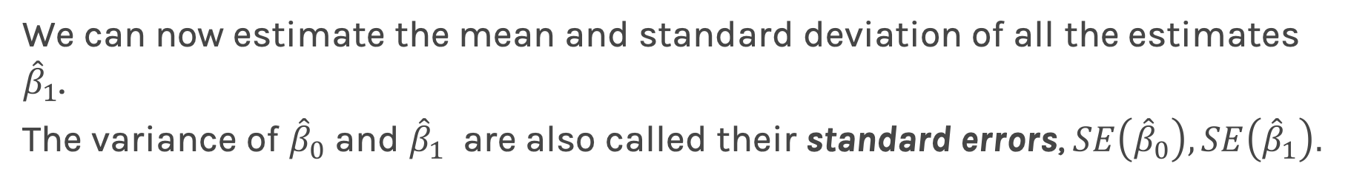
Confidence intervals for the predictors estimates (cont)
We can now estimate the mean and standard deviation of all the estimates ${\hat{β}}_{1}$.
The variance of ${\hat{β}}_{0}$ and ${\hat{β}}_{1}$ are also called their standard errors, $SE\left({\hat{β}}_{0}\right),SE\left({\hat{β}}_{1}\right).$
2

Slide 29
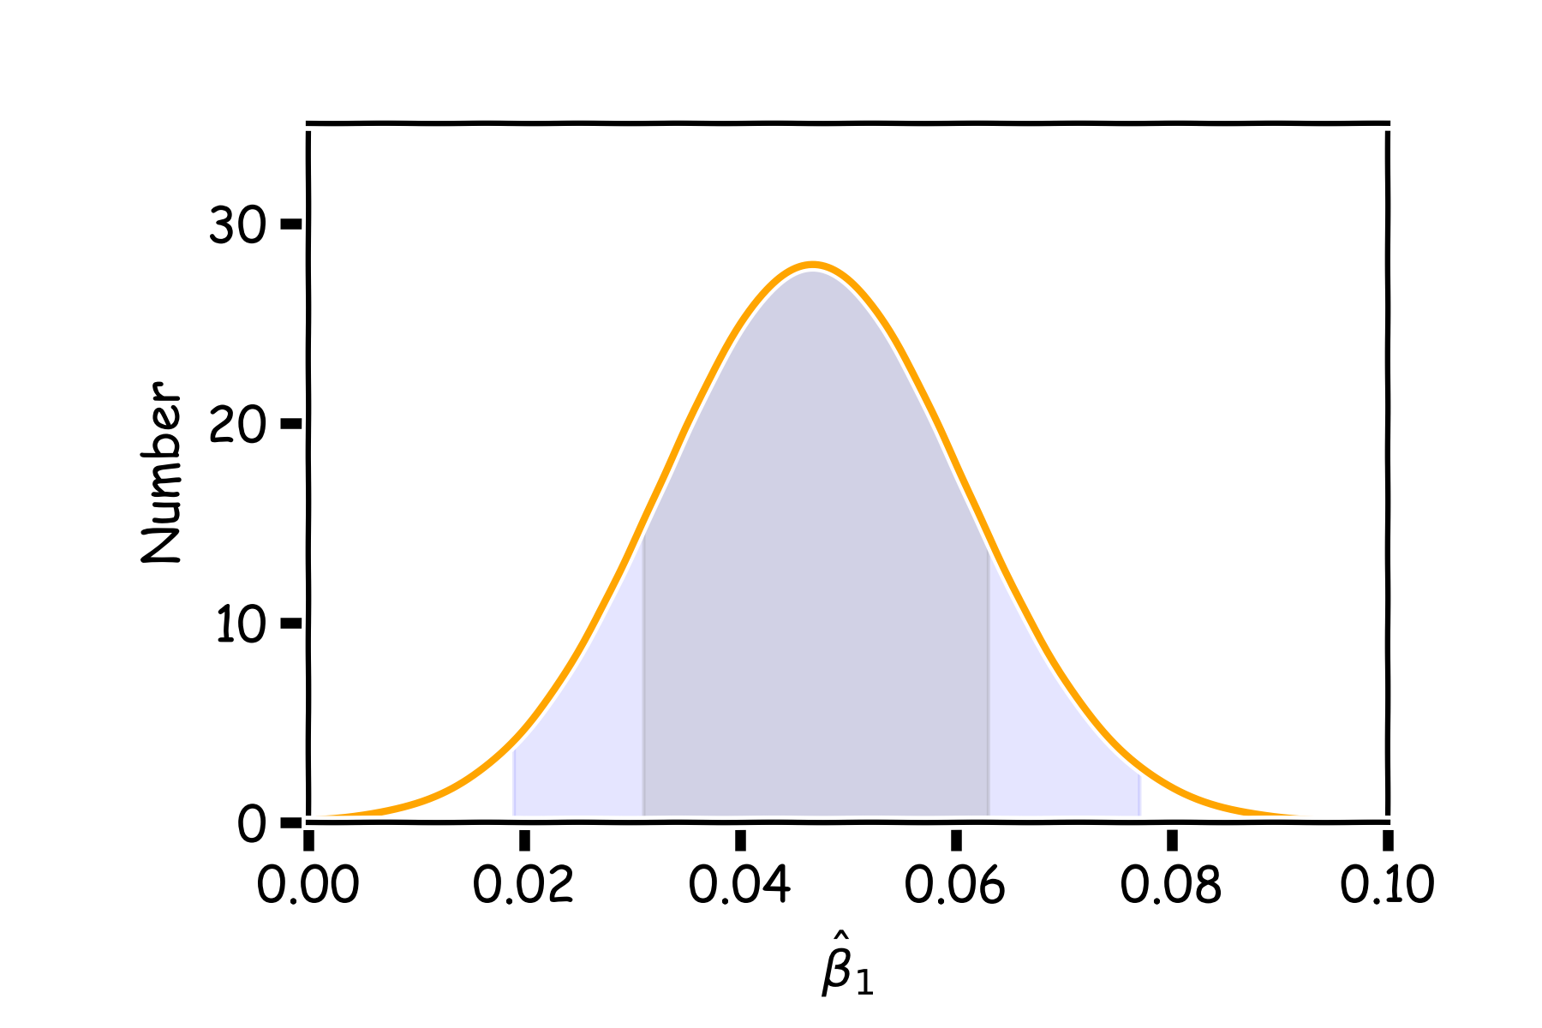
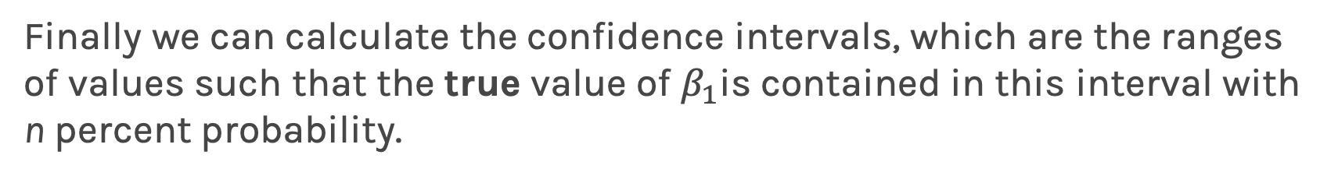
Confidence intervals for the predictors estimates (cont)
Finally we can calculate the confidence intervals, which are the ranges of values such that the true value of $β_{1}$is contained in this interval with n percent probability.
95%
68%

Slide 30
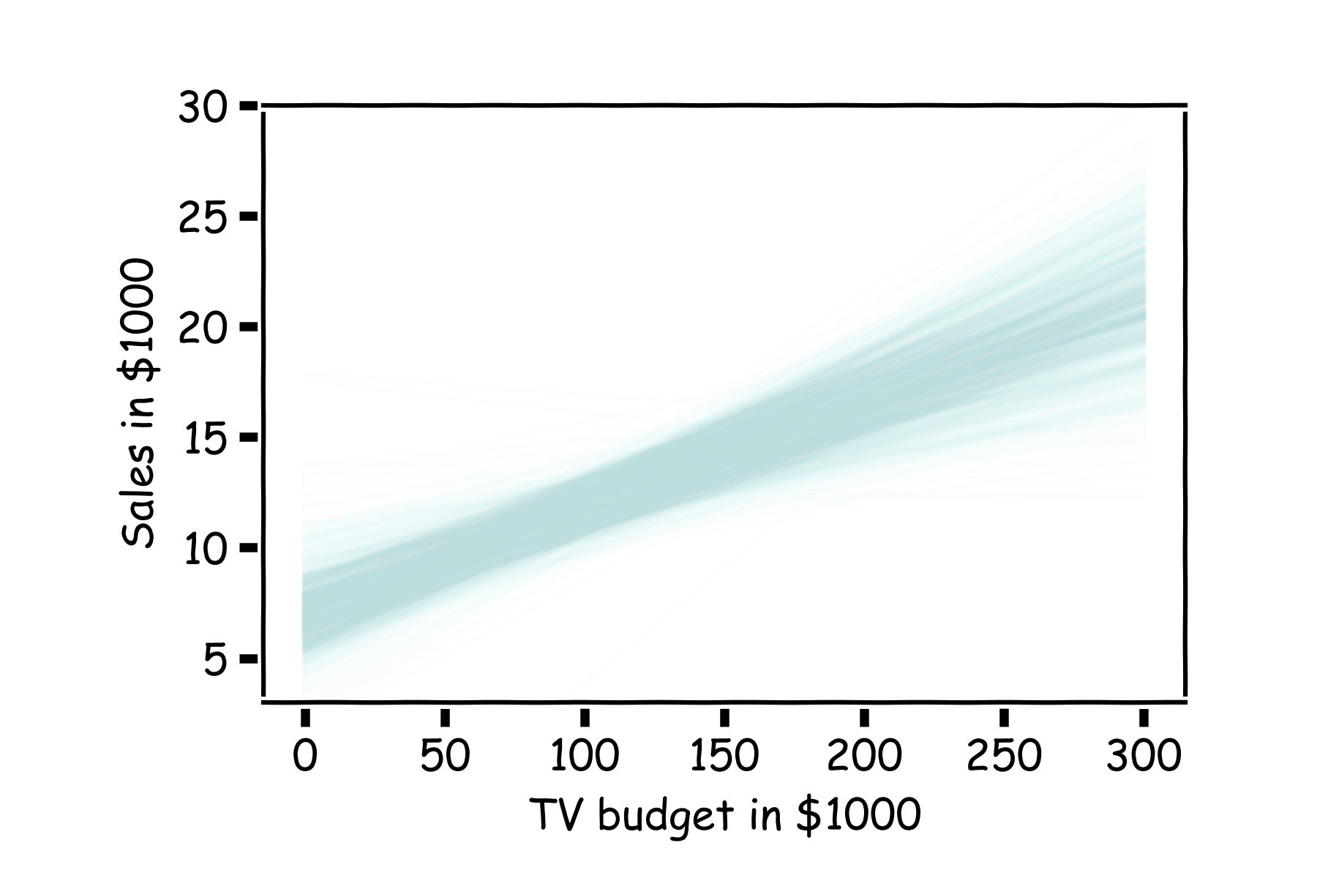
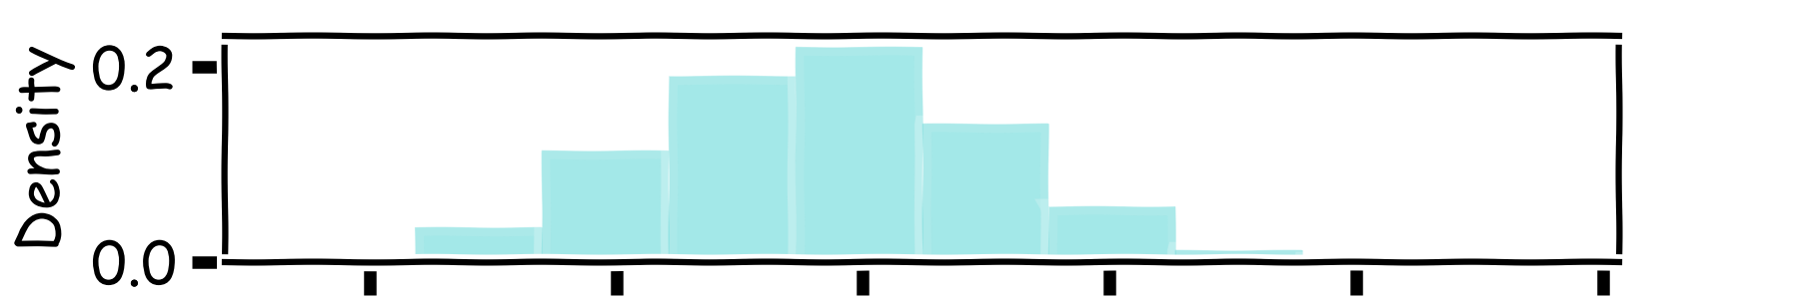
How well do we know $\hat{f}$?
Below we show all regression lines for a thousand of such bootstrapped samples.
For a given $x$, we examine the distribution of $\hat{f}$, and determine the mean and standard deviation.

Slide 31
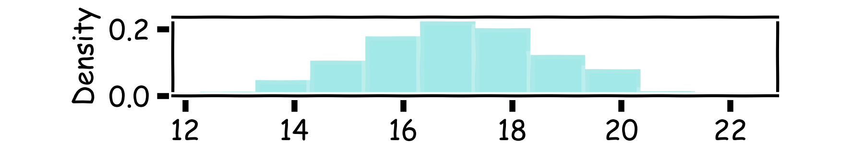
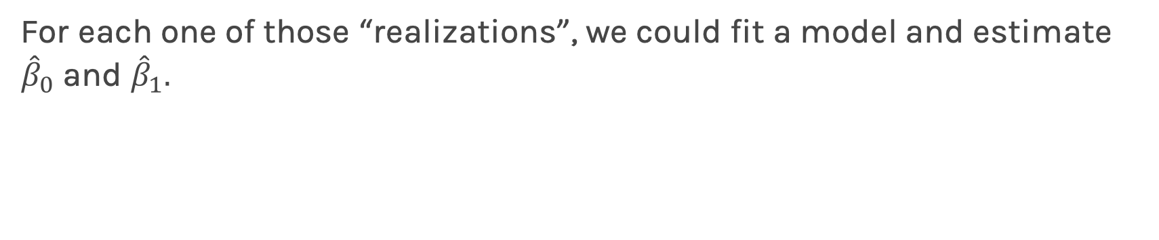
How well do we know $\hat{f}$?
Below we show all regression lines for a thousand of such sub-samples.
For a given $x$, we examine the distribution of $\hat{f}$, and determine the mean and standard deviation.

Slide 32
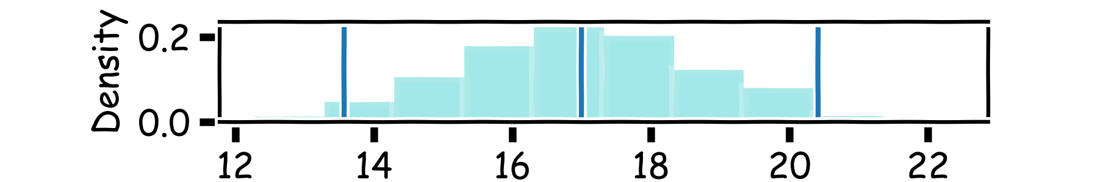
How well do we know $\hat{f}$?
Below we show all regression lines for a thousand of such sub-samples.
For a given $x$, we examine the distribution of $\hat{f}$, and determine the mean and standard deviation.

Slide 33
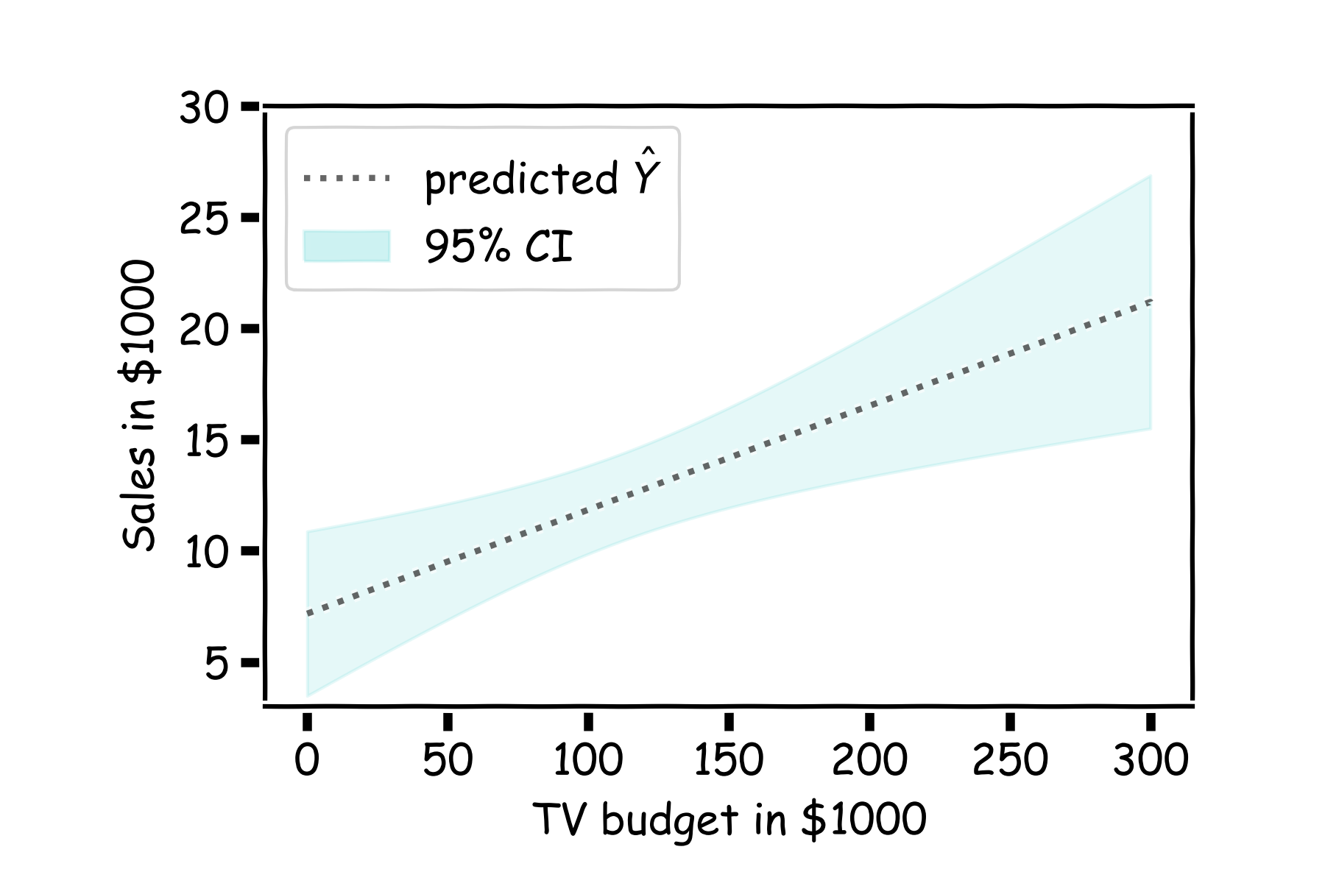
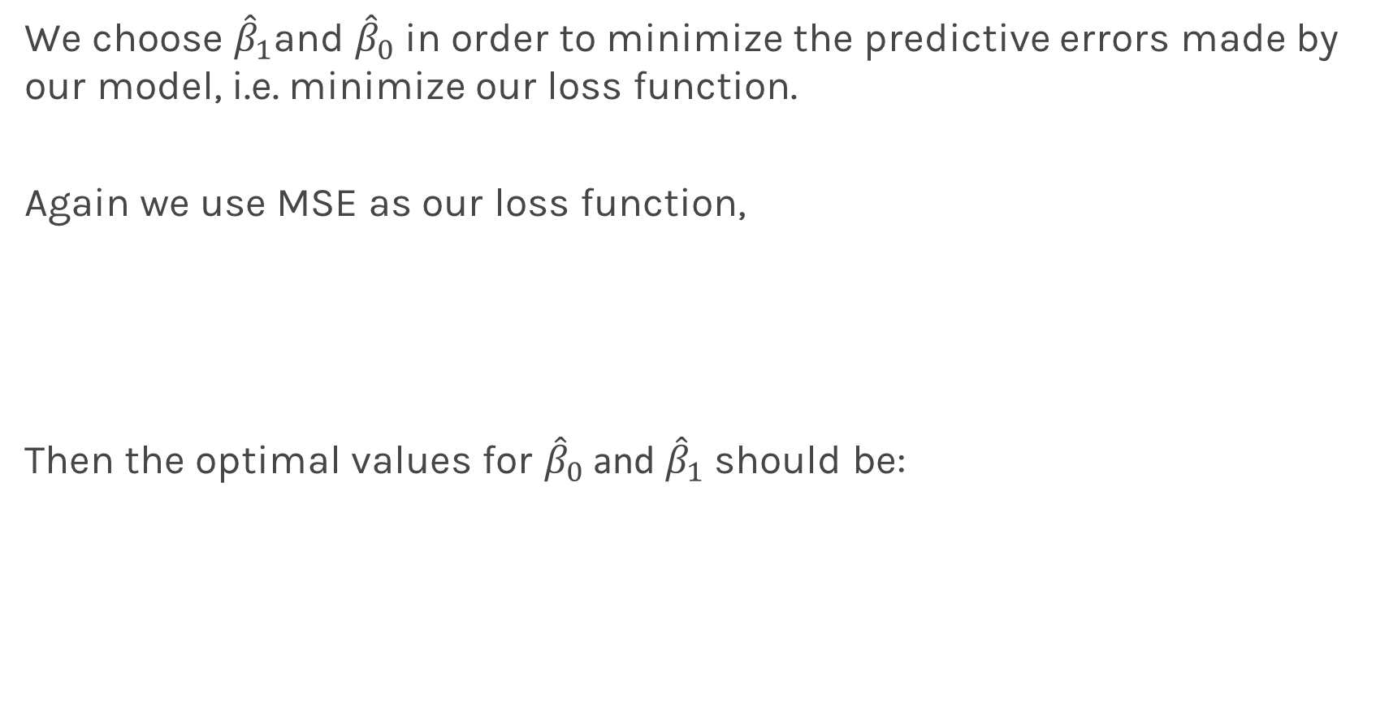
How well do we know $\hat{f}$?
For every $x$, we calculate the mean of the models, $\hat{f}$ (shown with dotted line) and the 95% CI of those models (shaded area).
Estimated $\hat{f}$

Slide 34
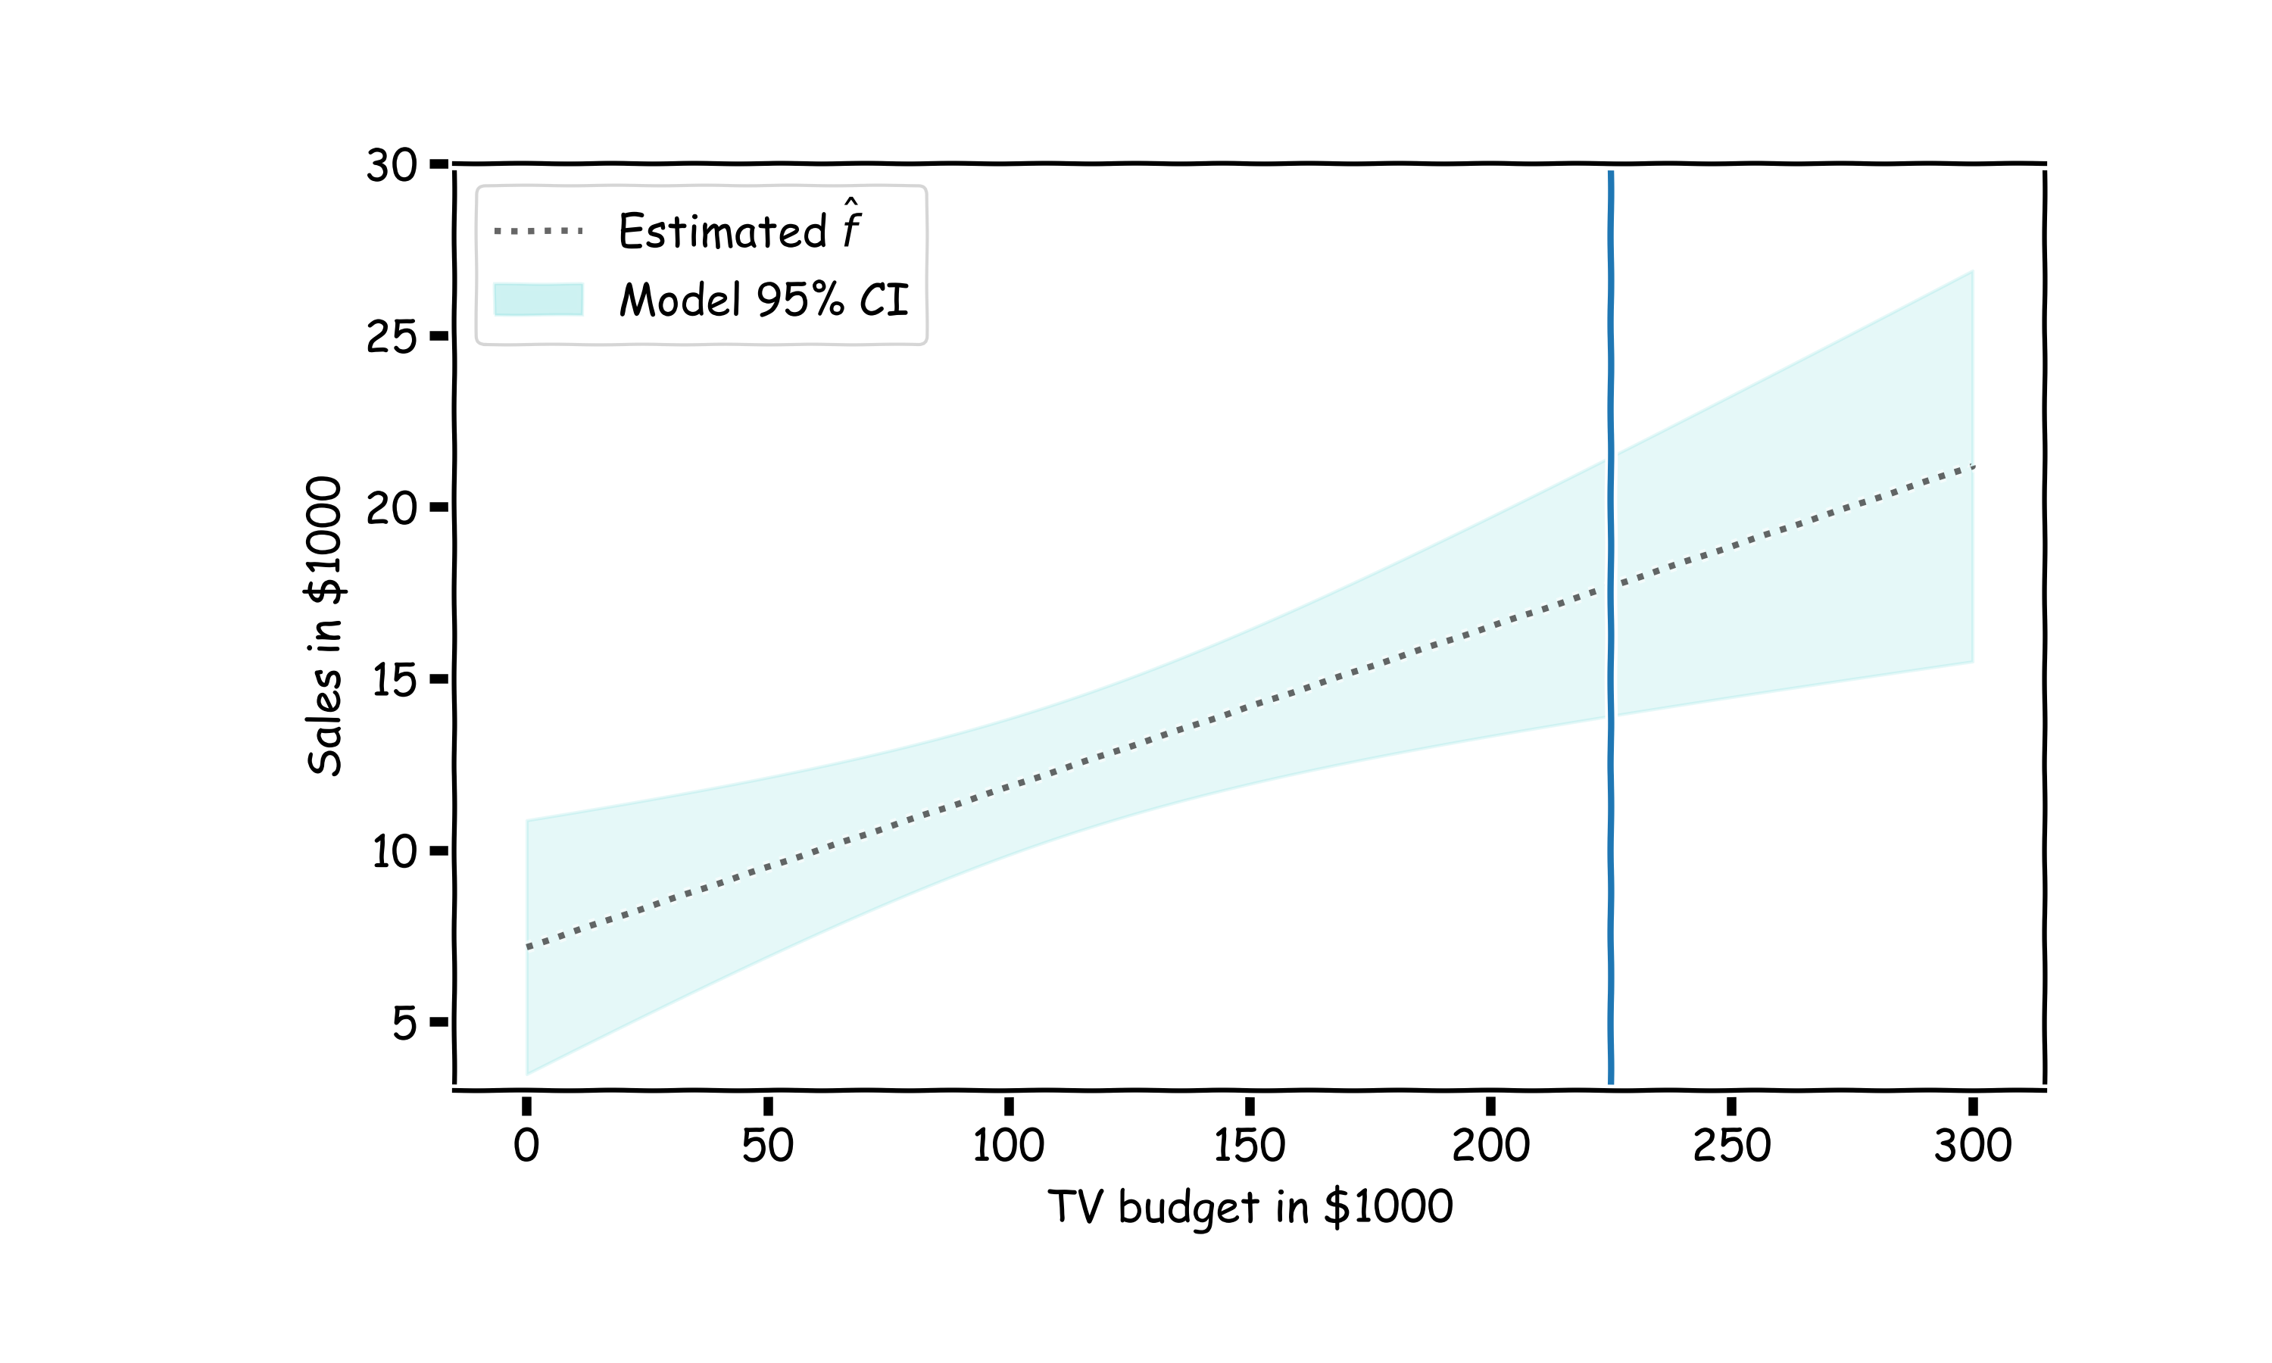
Confidence in predicting $\hat{y}$

Slide 35

Confidence in predicting $\hat{y}$
for a given x, we have a distribution of models $f\left(x\right)$
for each of these $f\left(x\right),$the prediction for $y\sim N(f, σ_{ε})$

Slide 36
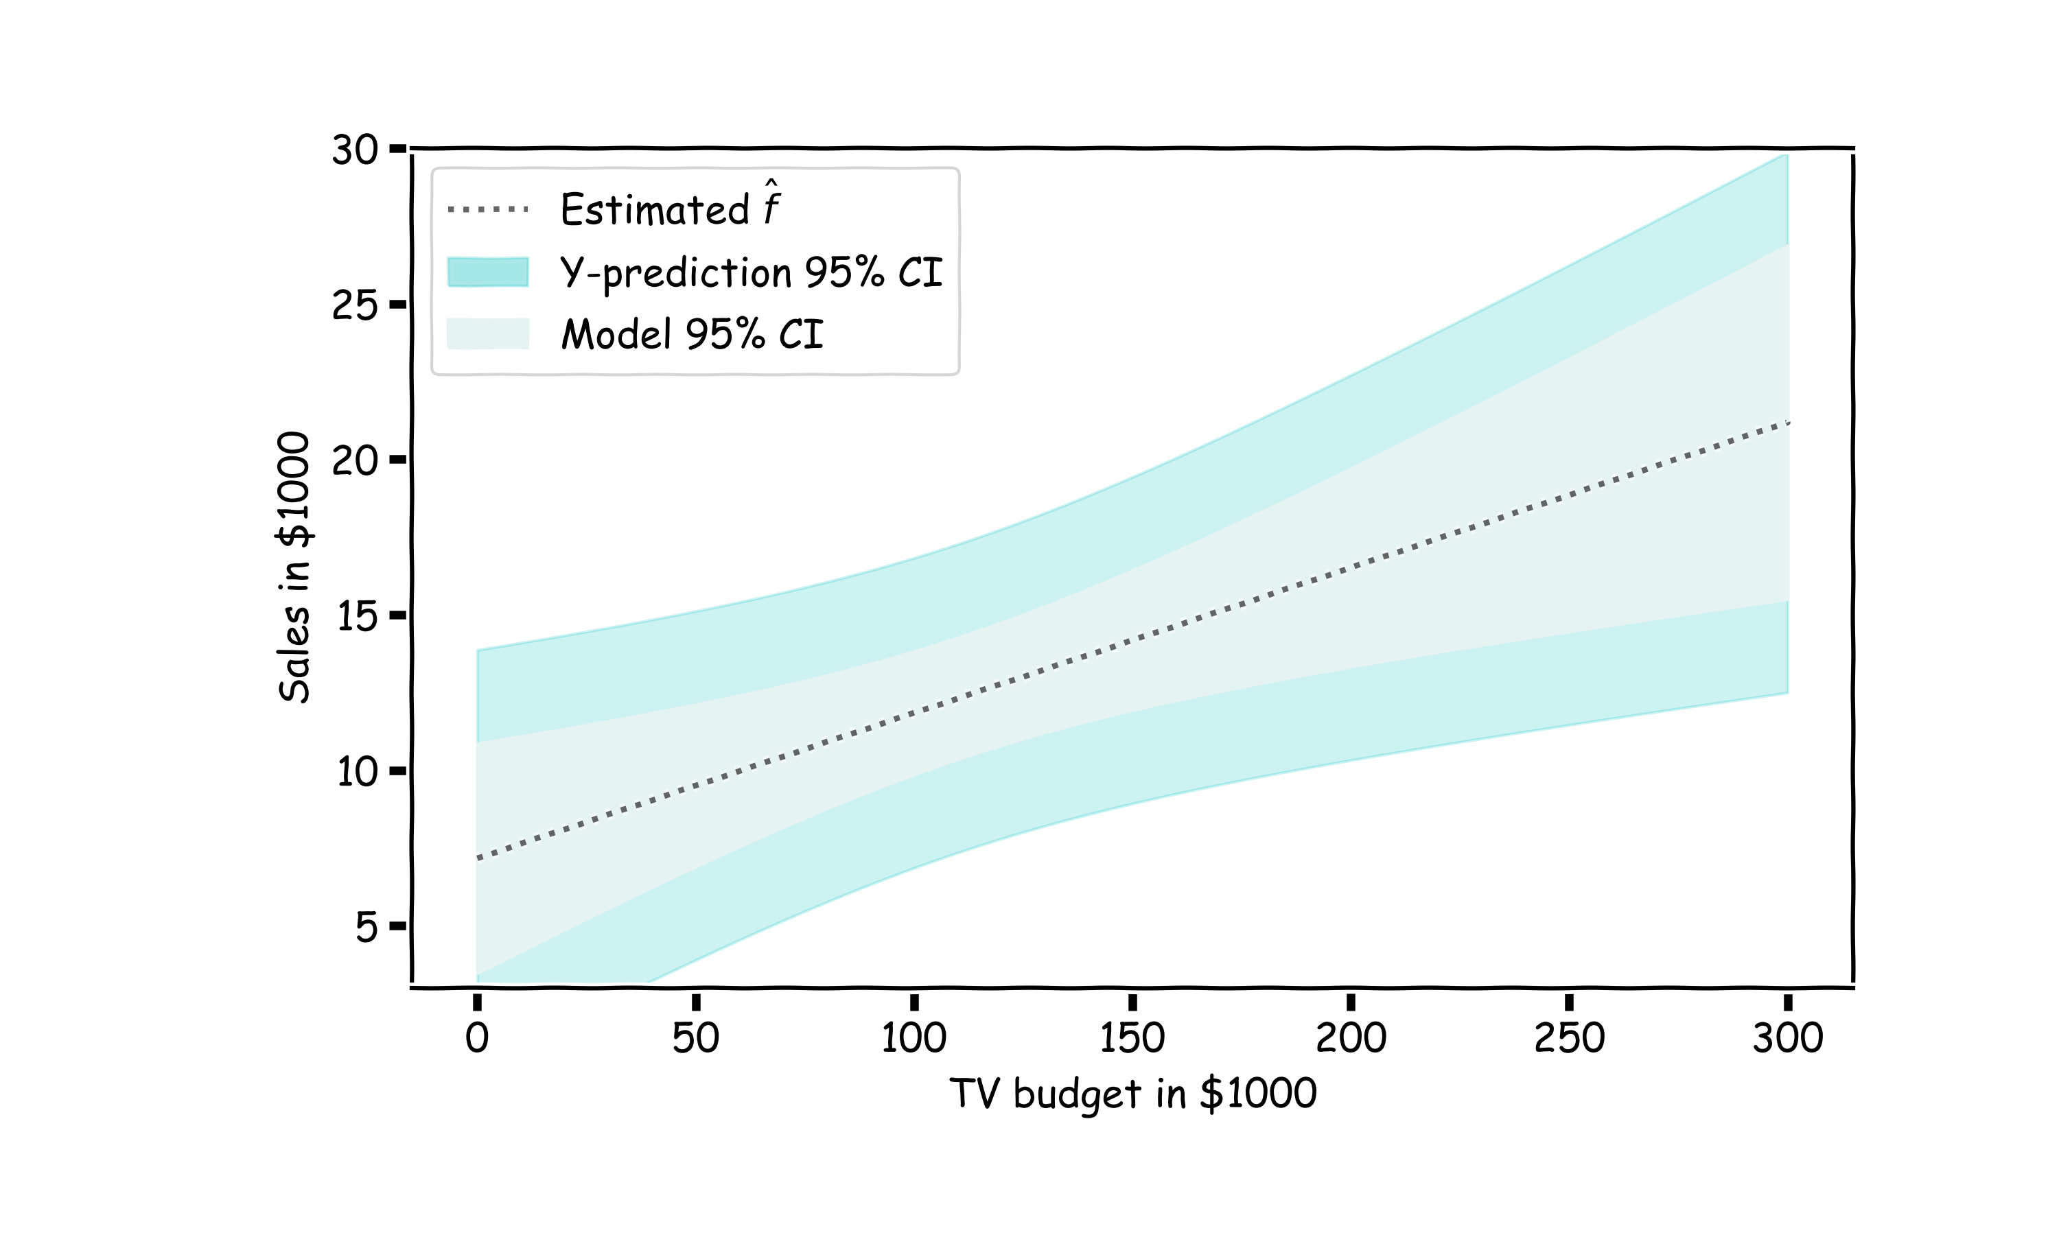
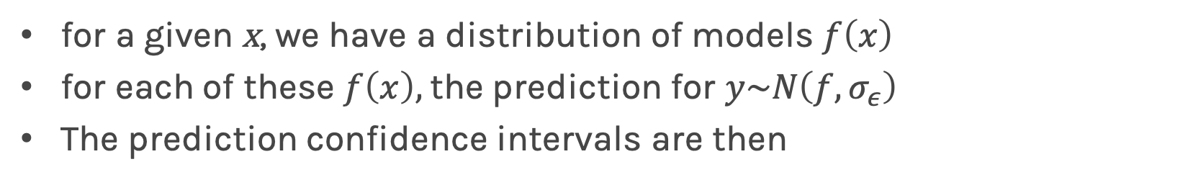
Confidence in predicting $\hat{y}$
for a given x, we have a distribution of models $f\left(x\right)$
for each of these $f\left(x\right),$the prediction for $y\sim N\left(f, σ_{ε}\right)$
The prediction confidence intervals are then

Slide 37
Uncertainty in model and prediction
Cross validation
Overfitting: Variance & Bias
Pandas
NumPy
Scikit-Learn
PCA & dimensionality reduction
Statistical Learning
Computing Tools
Matplotlib
Methods of regularization:
Lasso and Ridge
Regression
Classification
Logistic
Linear
Trees
KNN
Neural Networks
Experimental Design & Causal Inference

Slide 38
Uncertainty in model and prediction
Cross validation
Overfitting: Variance & Bias
Pandas
NumPy
Scikit-Learn
PCA & dimensionality reduction
Statistical Learning
Computing Tools
Matplotlib
Methods of regularization:
Lasso and Ridge
Regression
Classification
Logistic
Linear
Trees
KNN
Neural Networks
Experimental Design & Causal Inference

Slide 39
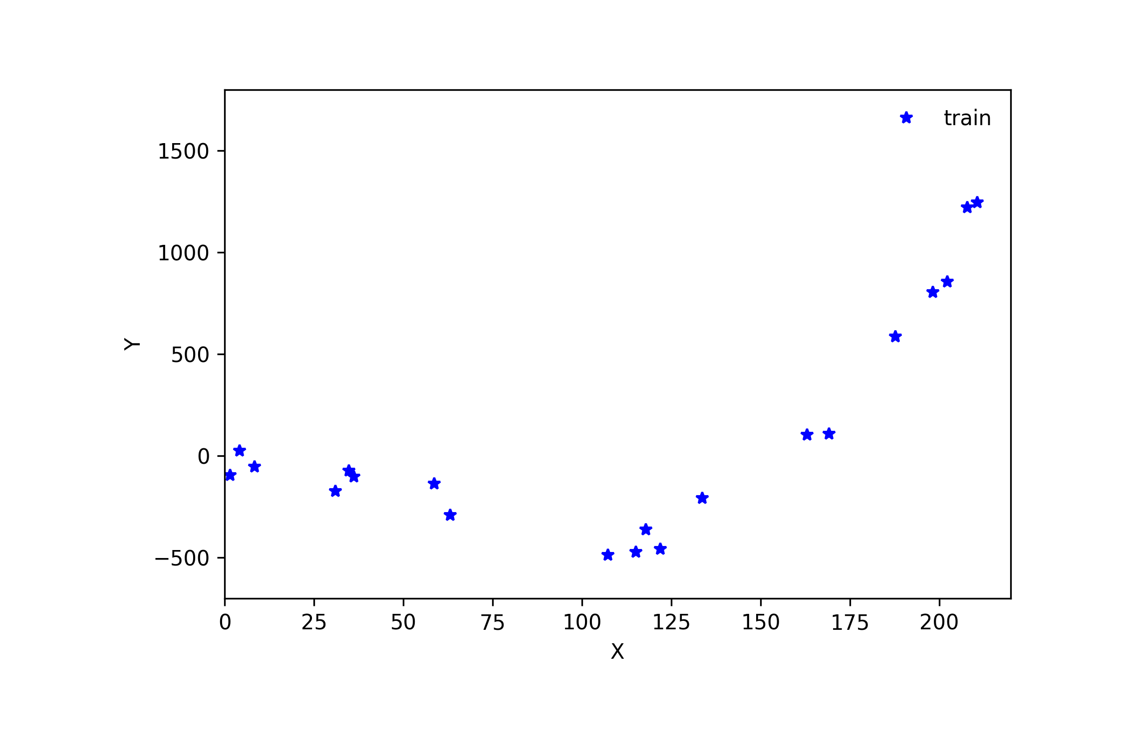
Cross Validation

Slide 40
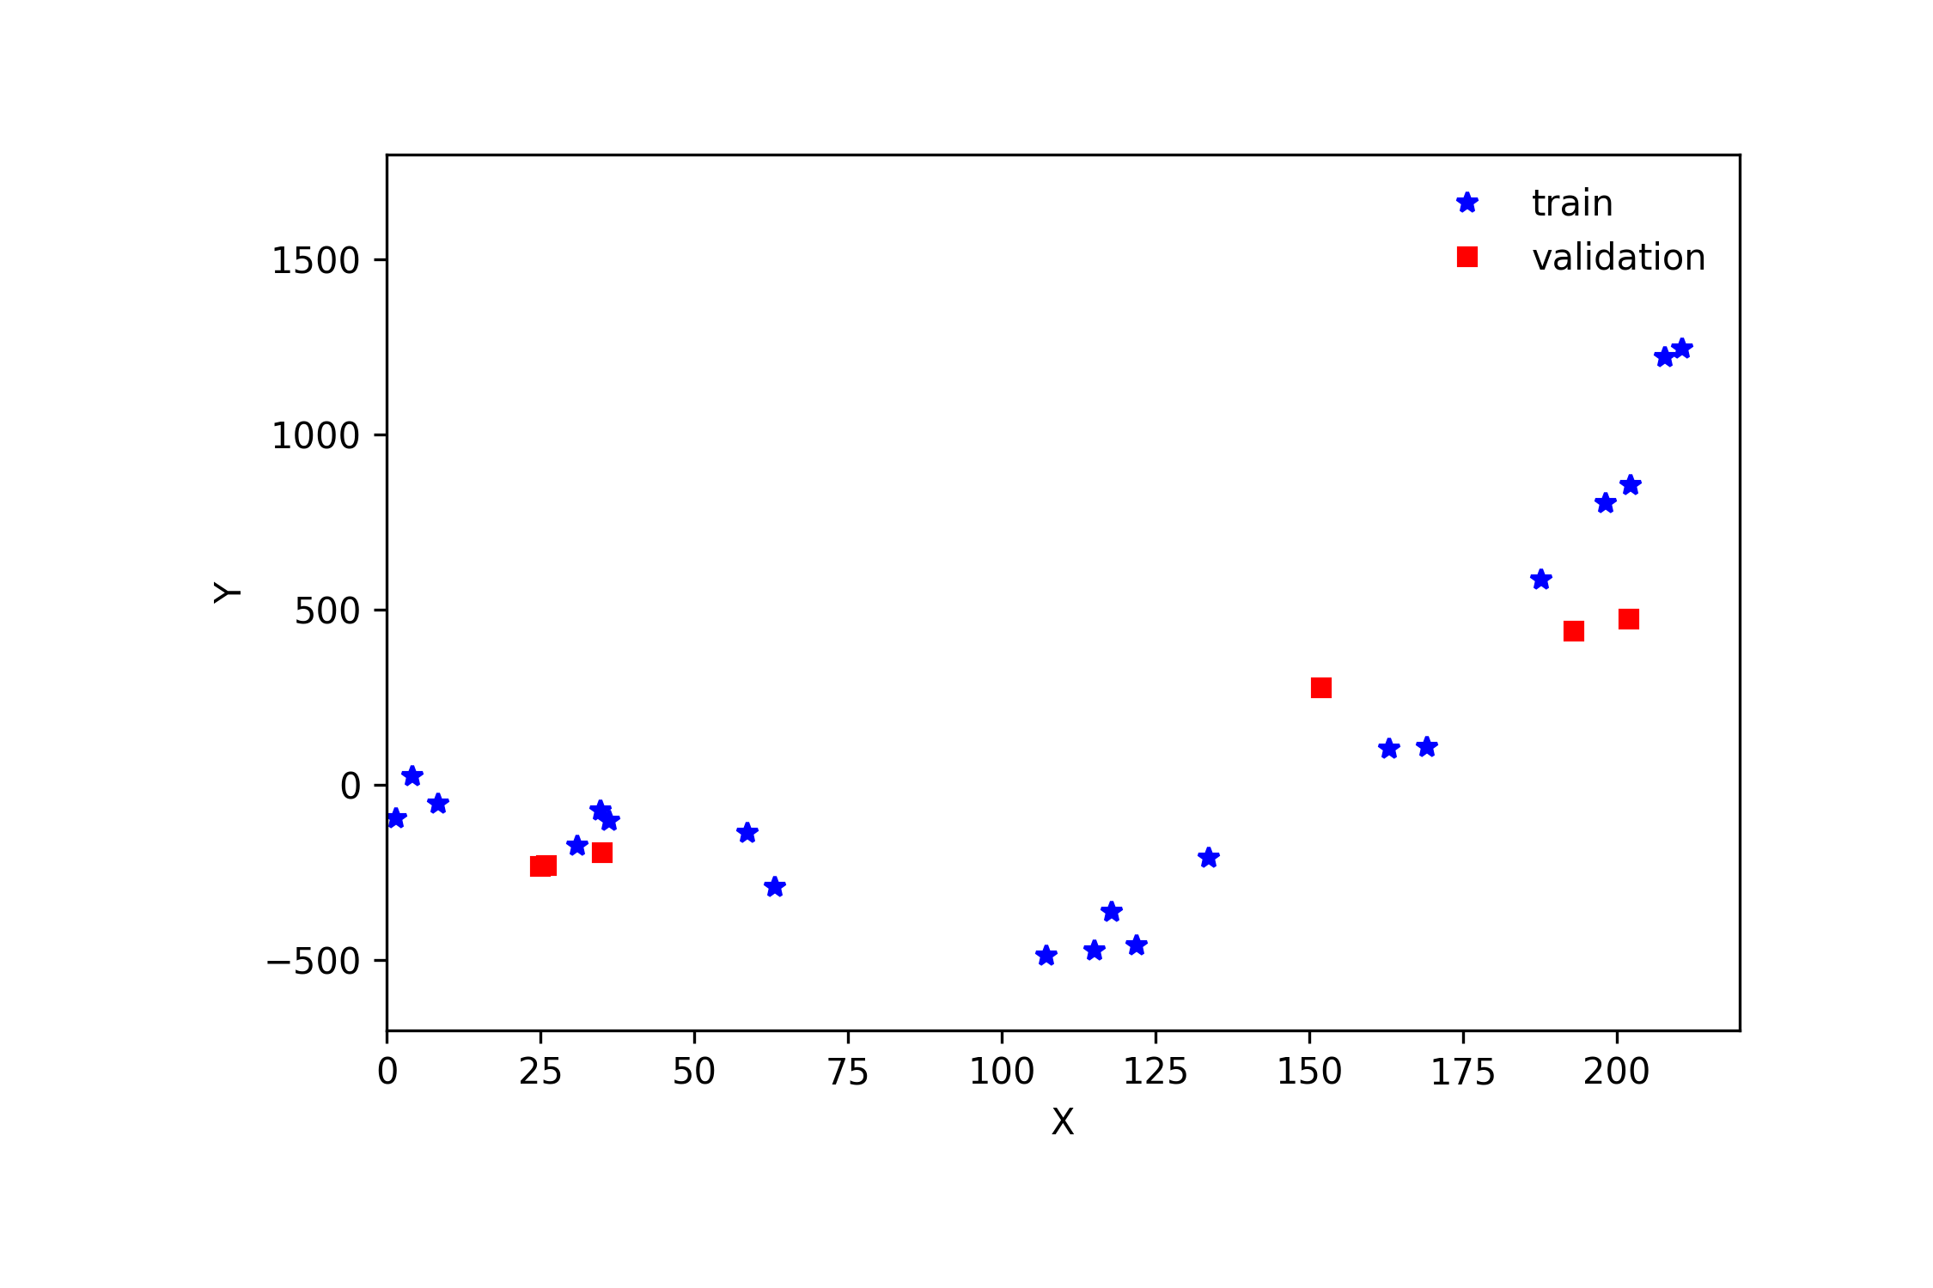
Cross Validation

Slide 41
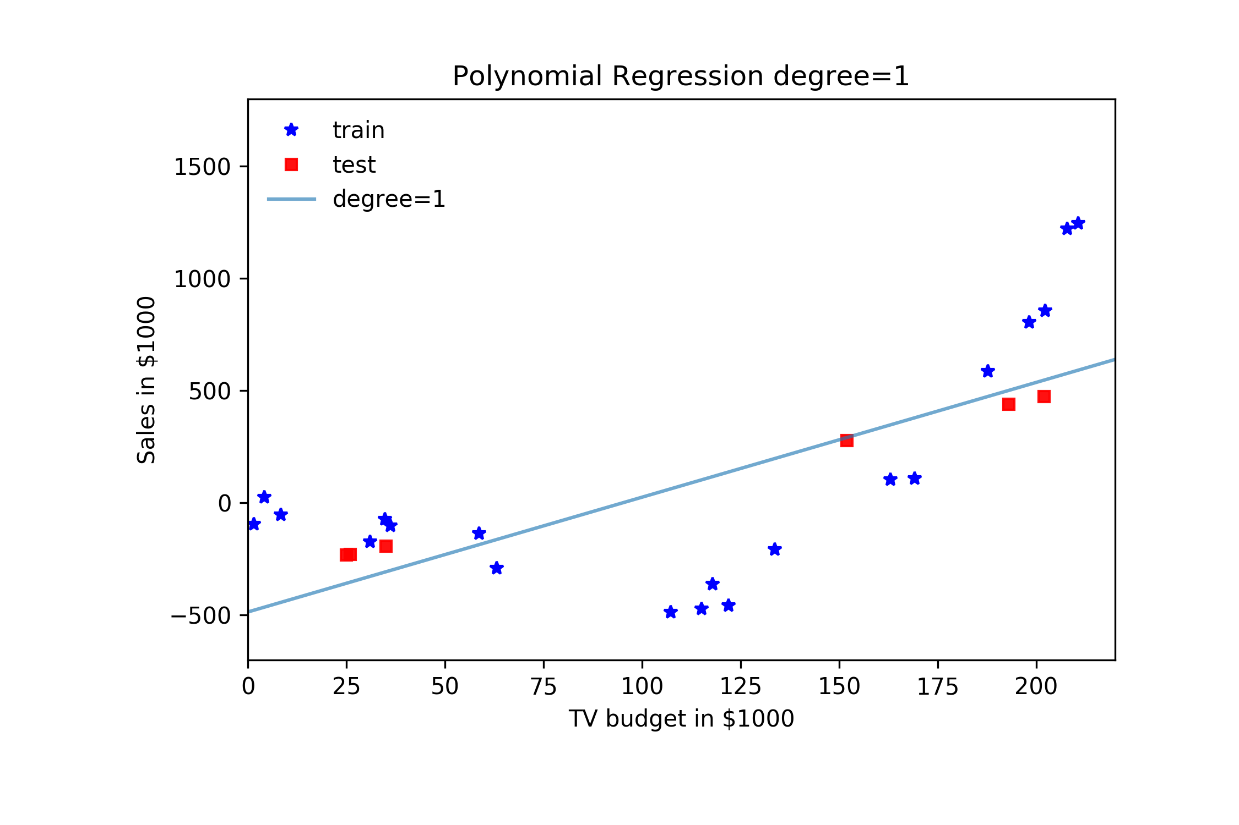
Cross Validation

Slide 42
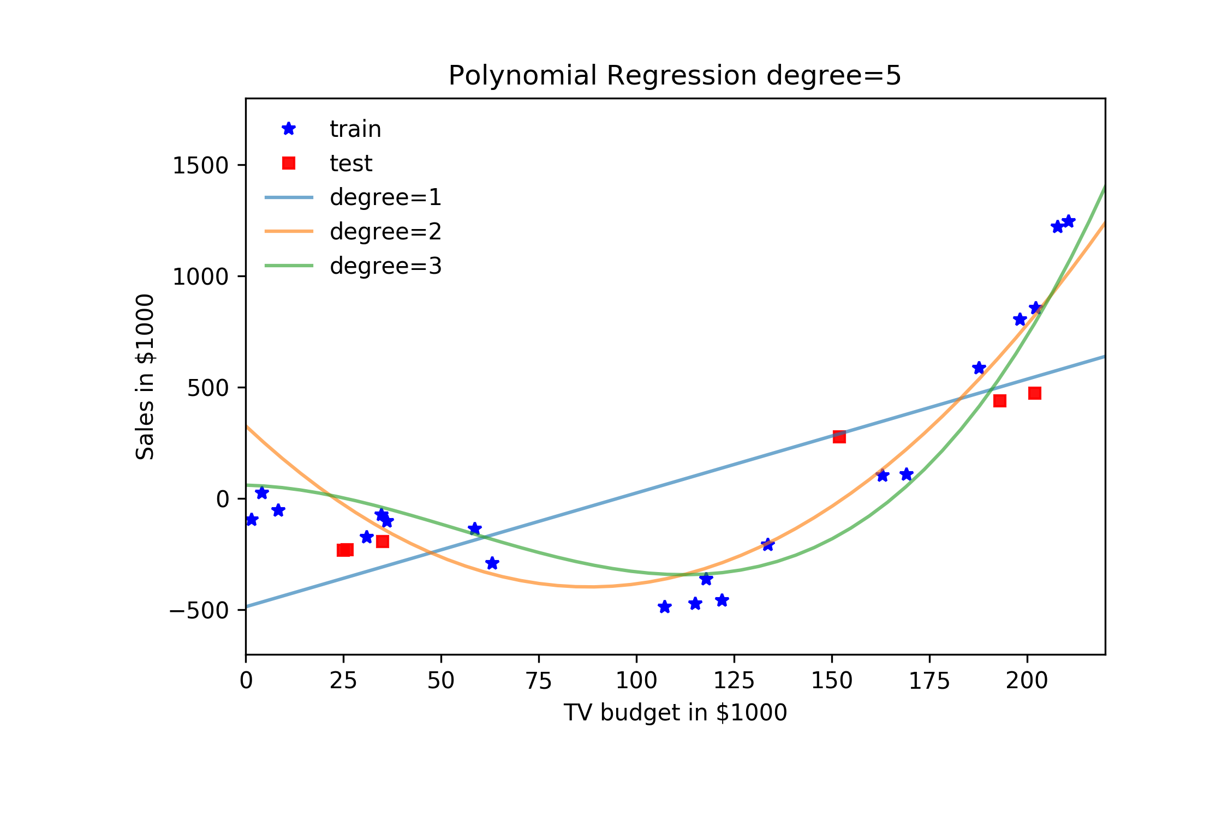
Cross Validation

Slide 43
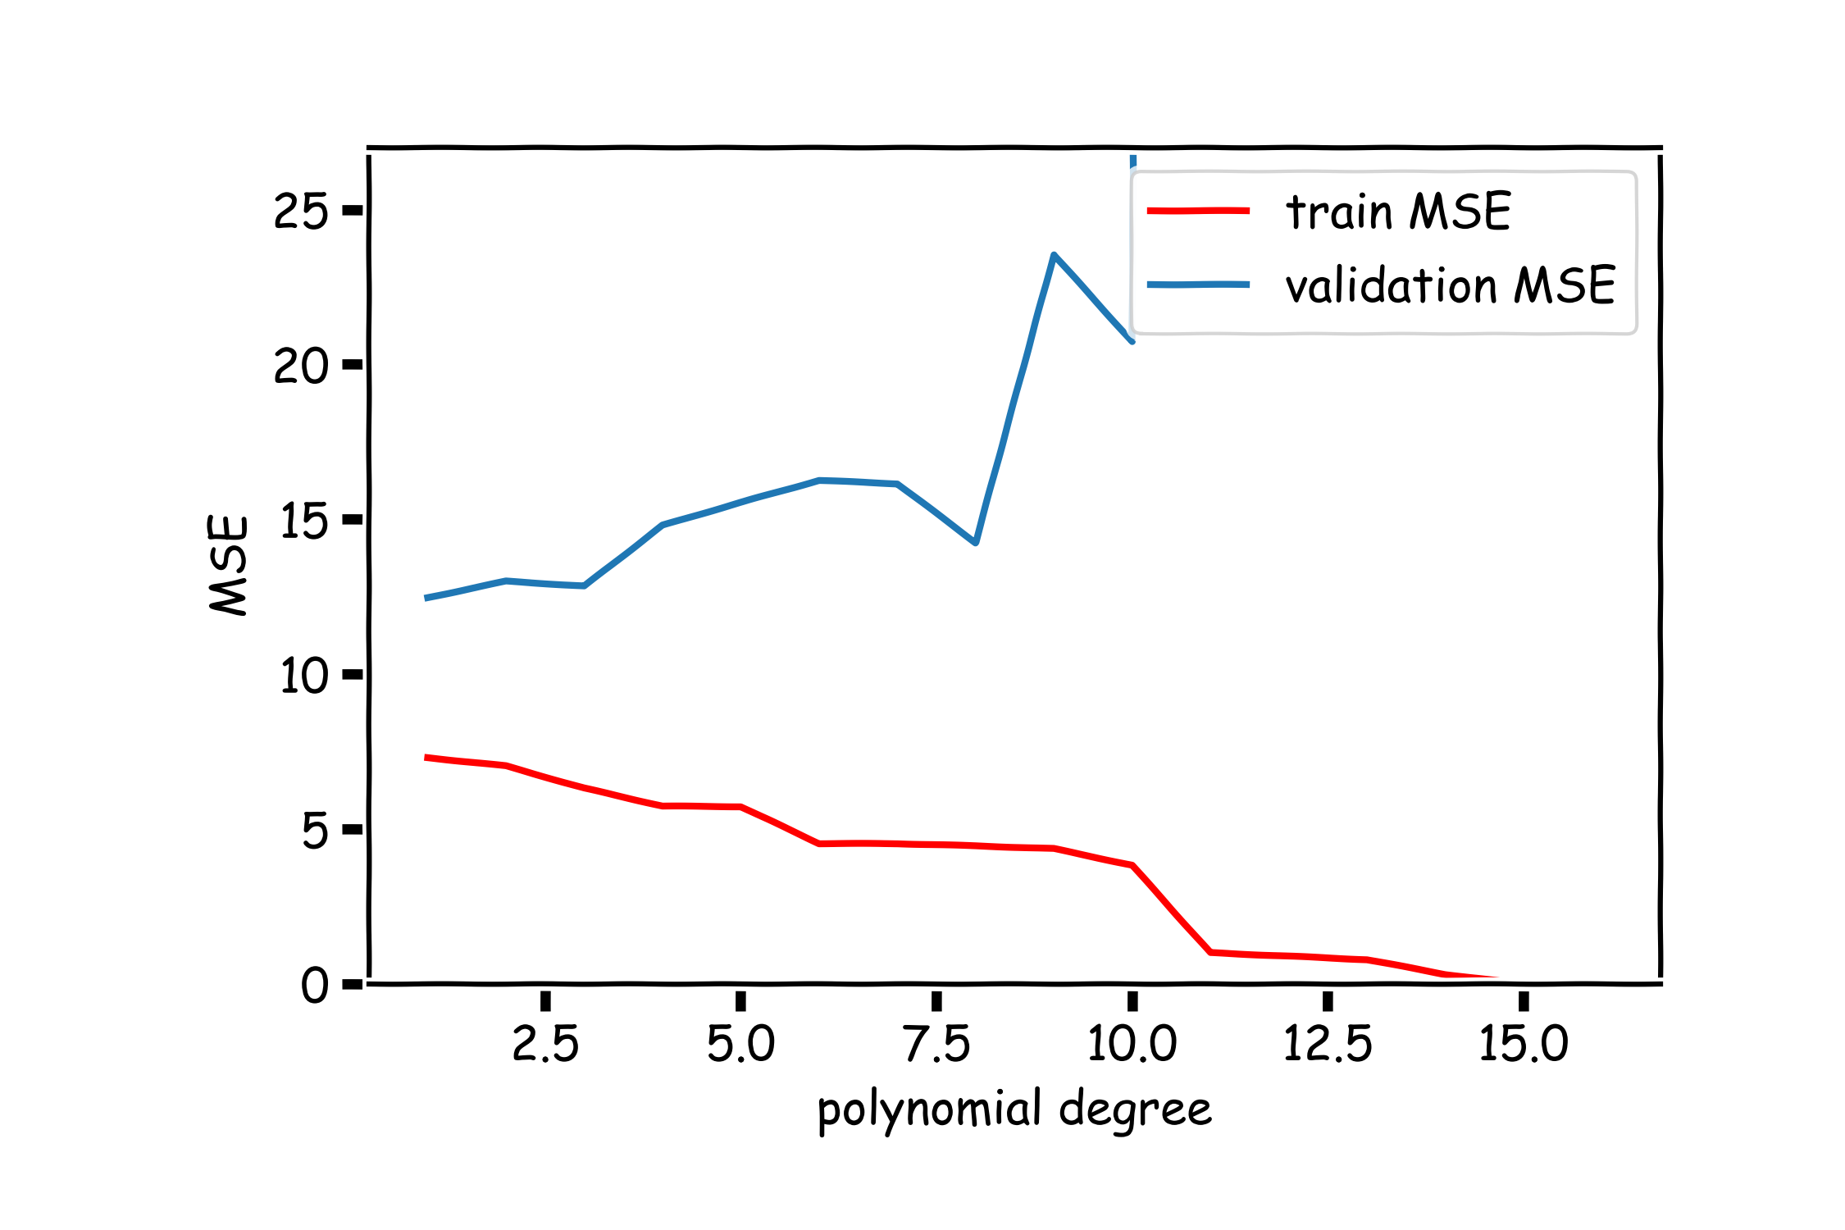
Validation

Slide 44
Cross Validation

Slide 45
Uncertainty in model and prediction
Cross validation
Overfitting: Variance & Bias
Pandas
NumPy
Scikit-Learn
PCA & dimensionality reduction
Statistical Learning
Computing Tools
Matplotlib
Methods of regularization:
Lasso and Ridge
Regression
Classification
Logistic
Linear
Trees
KNN
Neural Networks
Experimental Design & Causal Inference

Slide 46
Uncertainty in model and prediction
Cross validation
Overfitting: Variance & Bias
Pandas
NumPy
Scikit-Learn
PCA & dimensionality reduction
Statistical Learning
Computing Tools
Matplotlib
Methods of regularization:
Lasso and Ridge
Regression
Classification
Logistic
Linear
Trees
KNN
Neural Networks
Experimental Design & Causal Inference

Slide 49
Uncertainty in model and prediction
Cross validation
Overfitting: Variance & Bias
Pandas
NumPy
Scikit-Learn
PCA & dimensionality reduction
Statistical Learning
Computing Tools
Matplotlib
Methods of regularization:
Lasso and Ridge
Regression
Classification
Logistic
Linear
Trees
KNN
Neural Networks
Experimental Design & Causal Inference

Slide 50
Uncertainty in model and prediction
Cross validation
Overfitting: Variance & Bias
Pandas
NumPy
Scikit-Learn
PCA & dimensionality reduction
Statistical Learning
Computing Tools
Matplotlib
Methods of regularization:
Lasso and Ridge
Regression
Classification
Logistic
Linear
Trees
KNN
Neural Networks
Experimental Design & Causal Inference

Slide 51
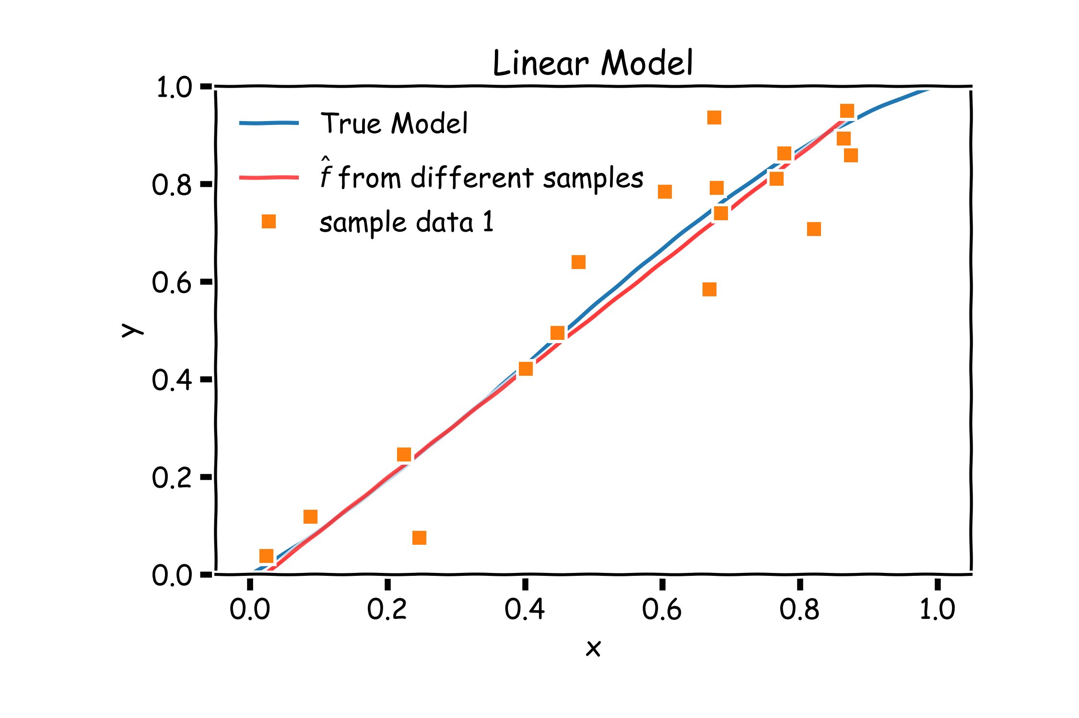
Bias vs Variance

Slide 52
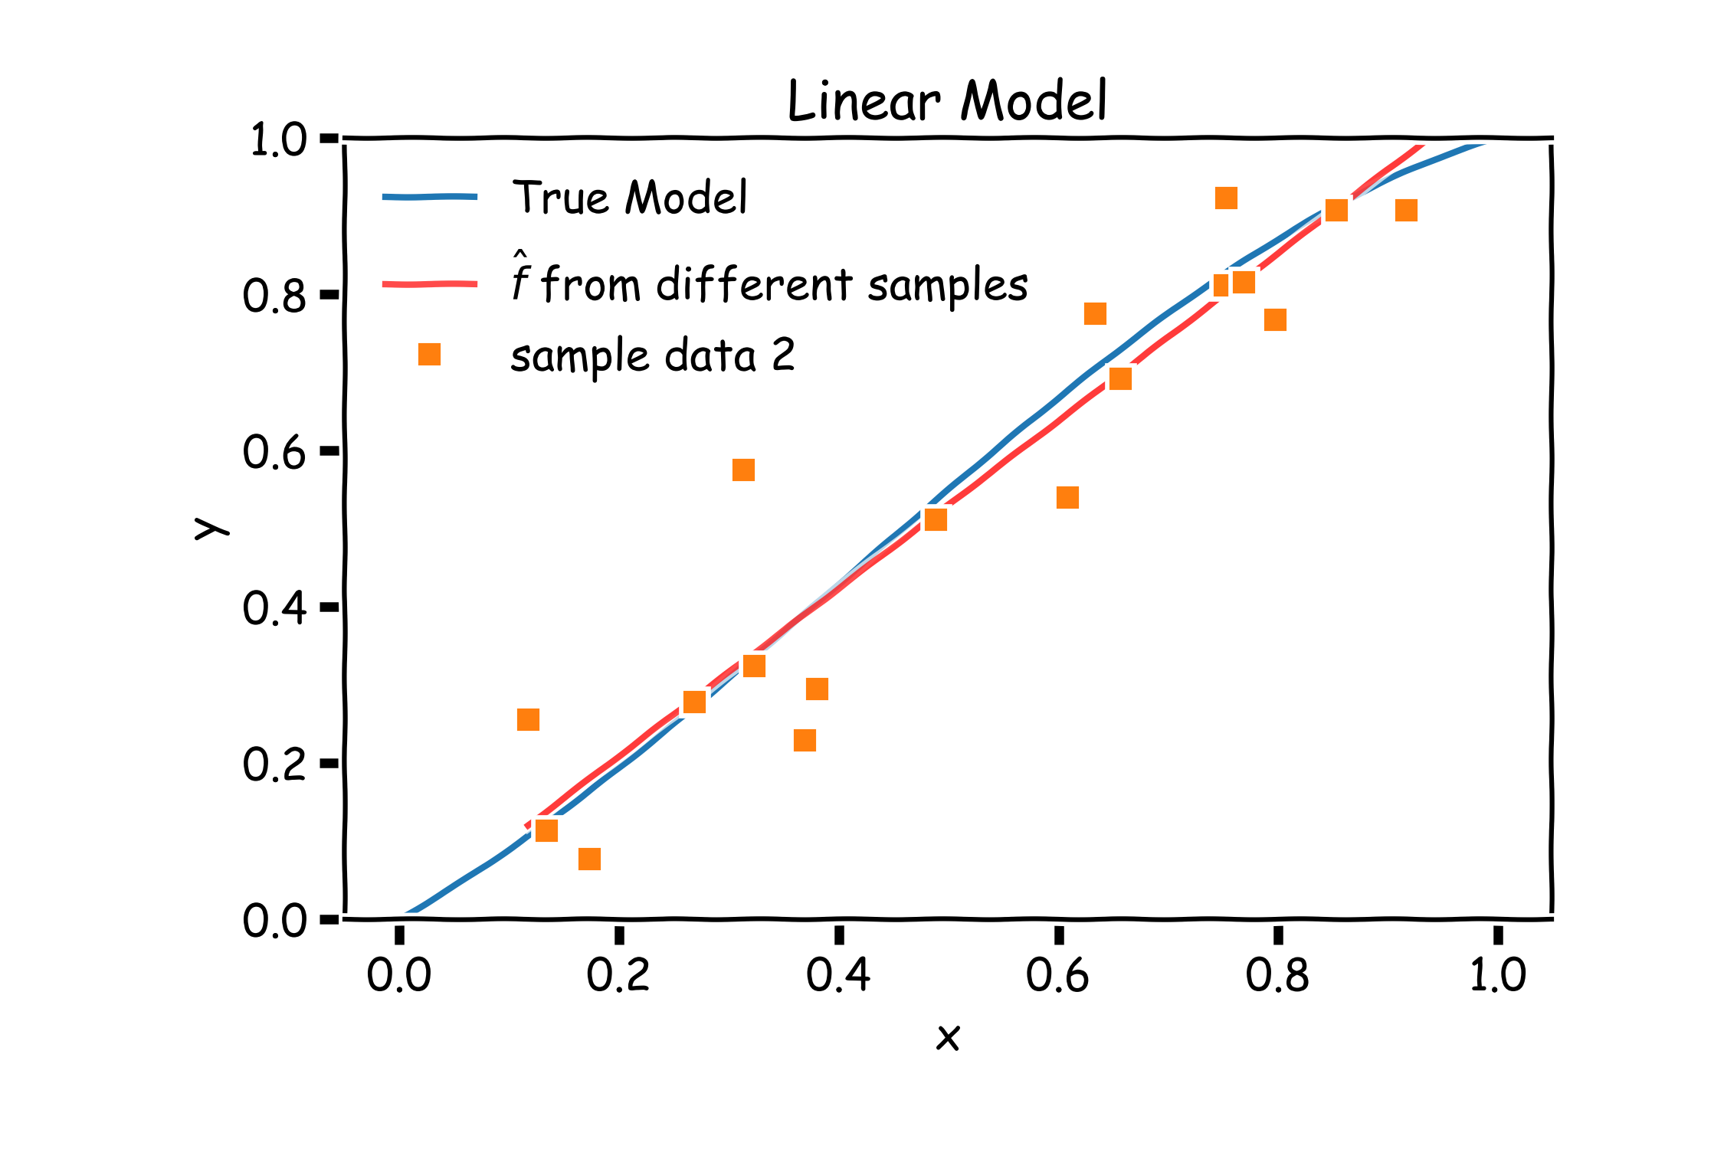
Bias vs Variance

Slide 53
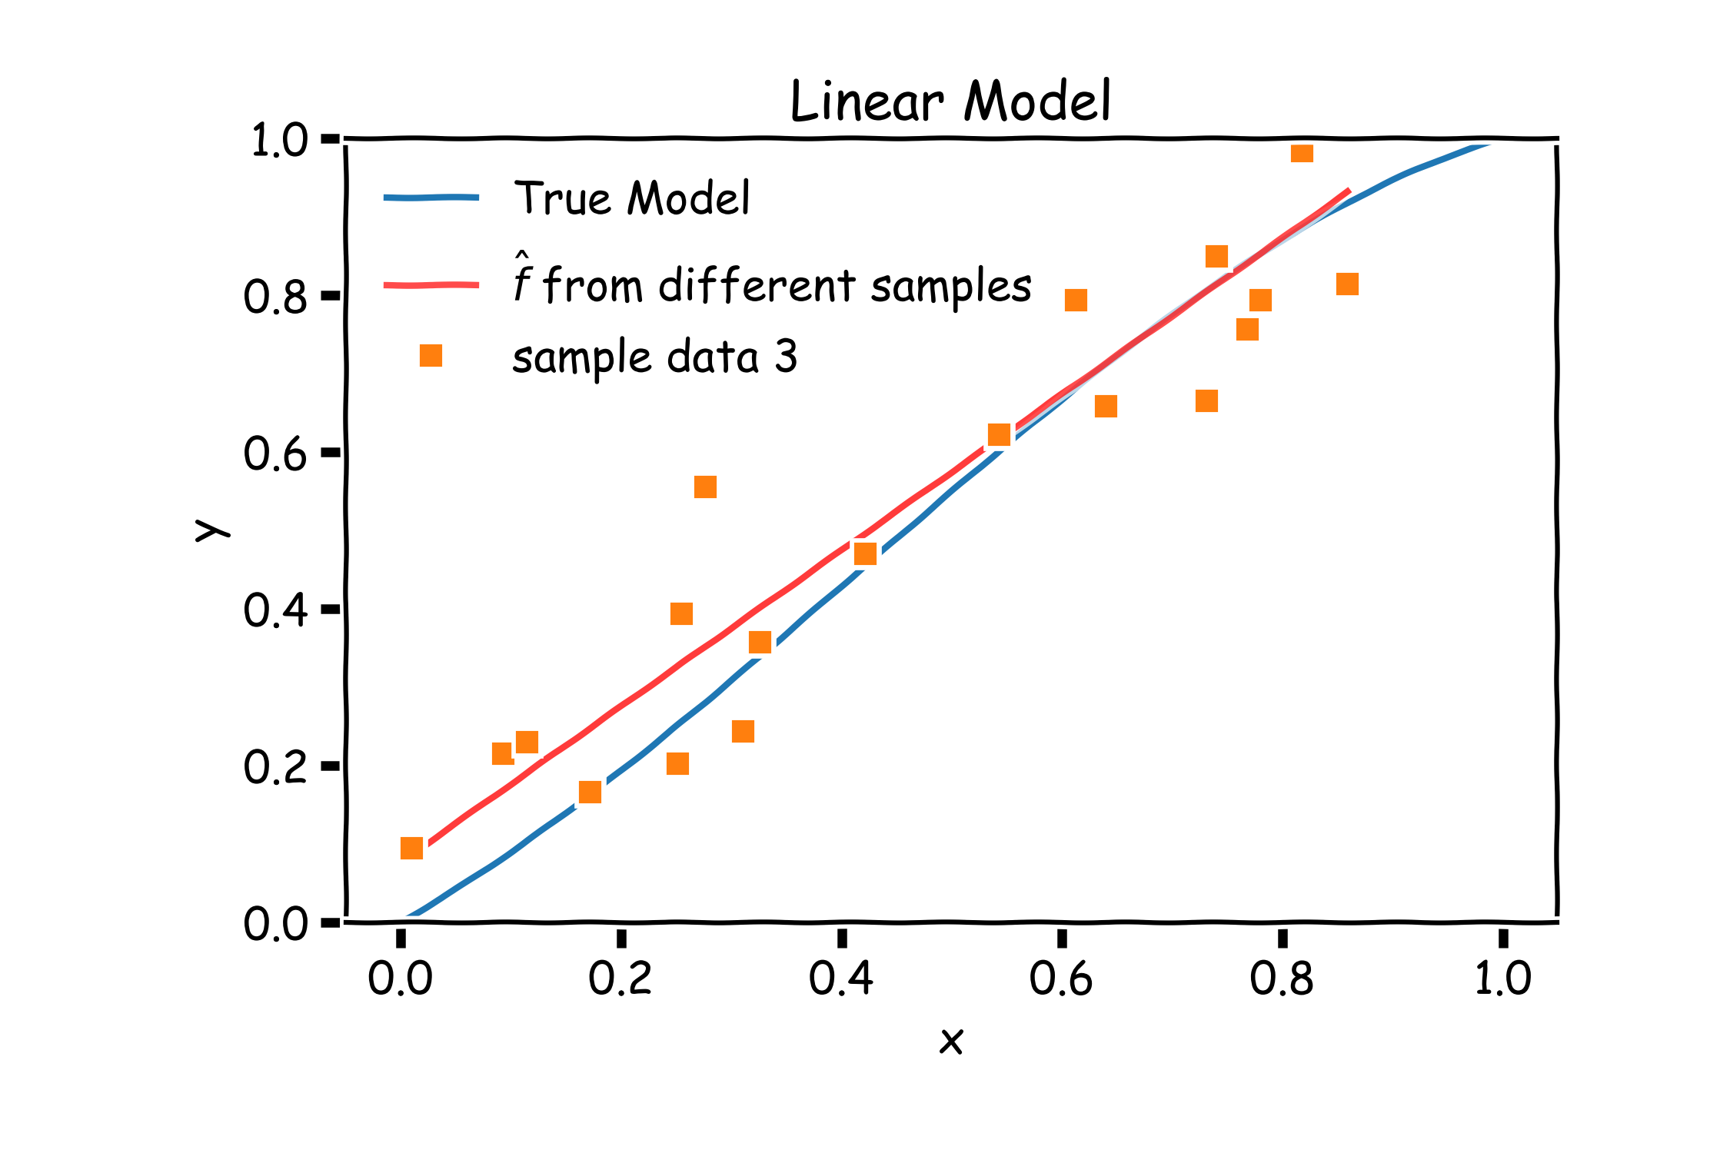
Bias vs Variance

Slide 54
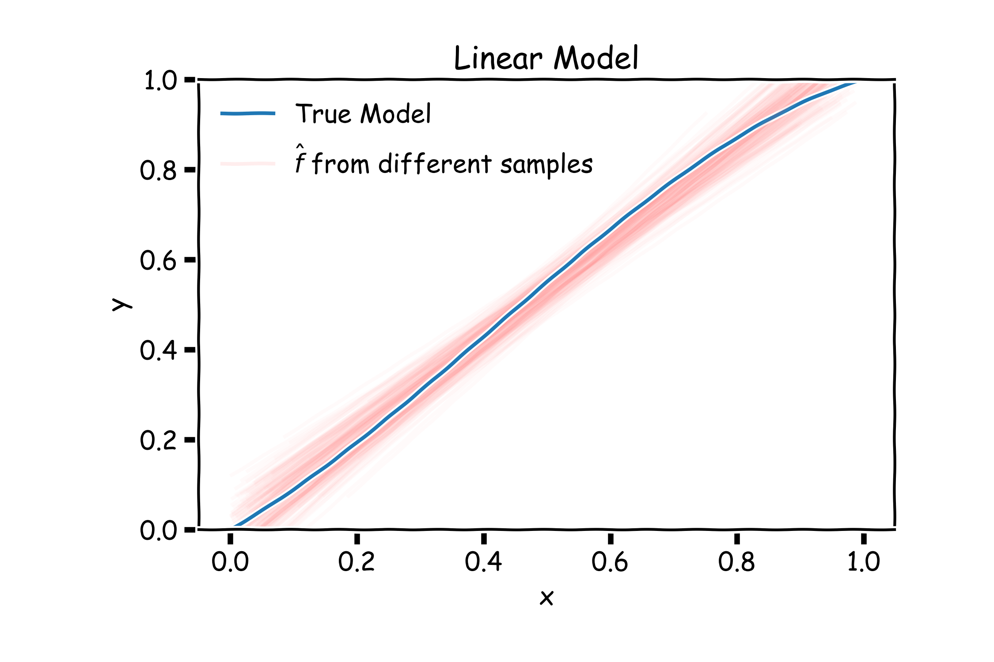
Linear models: 20 data points per line 2000 simulations

Slide 55
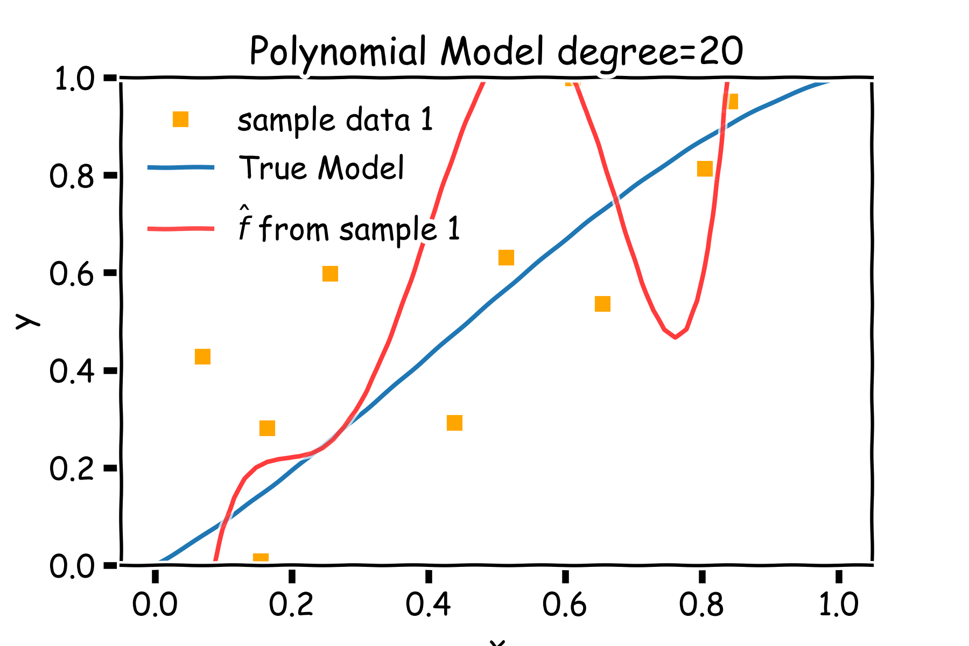
Bias vs Variance

Slide 56

Bias vs Variance

Slide 57

Bias vs Variance

Slide 58

Poly 10 degree models : 20 data points per line 2000 simulations

Slide 59
Bias vs Variance
Left: 2000 best fit straight lines, each fitted on a different 20 point training set.
Right: Best-fit models using degree 10 polynomial

Slide 60

Regularization: An Overview
The idea of regularization revolves around modifying the loss function L; in particular, we add a regularization term that penalizes some specified properties of the model parameters
where $λ$ is a scalar that gives the weight (or importance) of the regularization term.
Fitting the model using the modified loss function L_{reg} would result in model parameters with desirable properties (specified by R).

Slide 61
LASSO Regression
Since we wish to discourage extreme values in model parameter, we need to choose a regularization term that penalizes parameter magnitudes. For our loss function, we will again use MSE.
Together our regularized loss function is:
Note that is the l₁ norm of the vector β

Slide 62
Ridge Regression
Alternatively, we can choose a regularization term that penalizes the squares of the parameter magnitudes. Then, our regularized loss function is:
Note that is the l₂ norm of the vector β

Slide 63

Ridge regularization with validation only: step by step

Slide 64

Ridge regularization with validation only: step by step

Slide 65
Uncertainty in model and prediction
Cross validation
Overfitting: Variance & Bias
Pandas
NumPy
Scikit-Learn
PCA & dimensionality reduction
Statistical Learning
Computing Tools
Matplotlib
Methods of regularization:
Lasso and Ridge
Regression
Classification
Logistic
Linear
Trees
KNN
Neural Networks
Experimental Design & Causal Inference

Slide 66
Uncertainty in model and prediction
Cross validation
Overfitting: Variance & Bias
Pandas
NumPy
Scikit-Learn
PCA & dimensionality reduction
Statistical Learning
Computing Tools
Matplotlib
Methods of regularization:
Lasso and Ridge
Regression
Classification
Logistic
Linear
Trees
KNN
Neural Networks
Experimental Design & Causal Inference

Slide 67

The Intuition Behind PCA
Top PCA components capture the most of amount of variation (interesting features) of the data.
Each component is a linear combination of the original predictors - we visualize them as vectors in the feature space.

Slide 68

The Intuition Behind PCA (cont.)
Transforming our observed data means projecting our dataset onto the space defined by the top m PCA components, these components are our new predictors.

Slide 69
A Framework For Dimensionality Reduction
One way to reduce the dimensions of the feature space is to create a new, smaller set of predictors by taking linear combinations of the original predictors.
We choose Z₁, Z₂,…, Z_{m}, where $m≤p$ and where each Z_{i} is a linear combination of the original p predictors
$$Z_{i}=\sum_{j=1}^{p}{φ_{ji}X_{j}}$$
for fixed constants $φ_{ji}$. Then we can build a linear regression regression model using the new predictors
$$Y=β_{0}+β_{1}Z_{1}+…+β_{m}Z_{m}+ε$$
Notice that this model has a smaller number (m+1 < p+1) of parameters.

Slide 70


The Math behind PCA
PCA is a well-known result from linear algebra. Let Z be the n x p matrix consisting of columns Z₁,…, Z_{p} (the resulting PCA vectors), X be the n x p matrix of X₁,…, X_{p} of the original data variables (each standardized to have mean zero and variance one, and without the intercept), and let W be the p x p matrix whose columns are the eigenvectors of the square matrix X$T$X, then:

Slide 71
Uncertainty in model and prediction
Cross validation
Overfitting: Variance & Bias
Pandas
NumPy
Scikit-Learn
PCA & dimensionality reduction
Statistical Learning
Computing Tools
Matplotlib
Methods of regularization:
Lasso and Ridge
Regression
Classification
Logistic
Linear
Trees
KNN
Neural Networks
Experimental Design & Causal Inference

Slide 72
Uncertainty in model and prediction
Cross validation
Overfitting: Variance & Bias
Pandas
NumPy
Scikit-Learn
PCA & dimensionality reduction
Statistical Learning
Computing Tools
Matplotlib
Methods of regularization:
Lasso and Ridge
Regression
Classification
Logistic
Linear
Trees
KNN
Neural Networks
Experimental Design & Causal Inference

Slide 73
Uncertainty in model and prediction
Cross validation
Overfitting: Variance & Bias
Pandas
NumPy
Scikit-Learn
PCA & dimensionality reduction
Statistical Learning
Computing Tools
Matplotlib
Methods of regularization:
Lasso and Ridge
Regression
Classification
Logistic
Linear
Trees
KNN
Neural Networks
Experimental Design & Causal Inference

Slide 74
Uncertainty in model and prediction
Cross validation
Overfitting: Variance & Bias
Pandas
NumPy
Scikit-Learn
PCA & dimensionality reduction
Statistical Learning
Computing Tools
Matplotlib
Methods of regularization:
Lasso and Ridge
Regression
Classification
Logistic
Linear
Trees
KNN
Neural Networks
Experimental Design & Causal Inference

Slide 75

Even Simpler Classification Problem: Binary Response (cont)
What could go wrong with this linear regression model?
.

Slide 76



Pavlos Game #45
Think of a function that would do this for us
$$Y=f(x)$$

Slide 77




Logistic Regression
$$2β_{1}$$
$$−\frac{β_{0}}{β_{1}}$$
$$\frac{β_{1}}{4}$$

Slide 78


Estimation in Logistic Regression
Probability $Y=1: p$
Probability $Y=0: 1−p$
$${P\left(Y=y\right)=p}^{y}{(1−p)}^{(1−y)}$$
where:
$p=P(Y=1|X=x)$ and therefore p depends on X.
Thus not every p is the same for each individual measurement.

Slide 79


Likelihood
The likelihood of a single observation for p given x and y is:
Given the observations are independent, what is the likelihood function for p?
$$L\left(p_{i} | Y_{i}\right)=P\left(Y_{i}=y_{i}\right)=p_{i}^{y_{i}}{\left(1−p_{i}\right)}^{1−y_{i}}$$
$$L\left(p | Y\right)=\prod_{i}{P\left(Y_{i}=y_{i}\right)=\prod_{i}{p_{i}^{y_{i}}{\left(1−p_{i}\right)}^{1−y_{i}}}}$$
$$l\left(p | Y\right)=−\log{L\left(p | Y\right)=}−\sum_{i}{y_{i}\log{p_{i}+\left(1−y_{i}\right)\log{(1−p_{i})}}}$$

Slide 80

Loss Function
$$l\left(p | Y\right)=−\sum_{i}{{\left\lfloor y_{i}\log{\frac{1}{1+e^{−βX_{i}}}+\left(1−y_{i}\right)\log\left(1−\frac{1}{1+e^{−βX_{i}}}\right)}\right\rfloor }_{i} }$$
How do we minimize this?
Differentiate, equate to zero and solve for it!
But jeeze does this look messy?! It will not necessarily have a closed form solution.
So how do we determine the parameter estimates? Through an iterative approach (we will talk about this at length in future lectures).

Slide 81

Classifier with two predictors
How can we estimate a classifier, based on logistic regression, for the following plot?

Slide 82

Multiple Logistic Regression
Earlier we saw the general form of simple logistic regression, meaning when there is just one predictor used in the model. What was the model statement (in terms of linear predictors)?
Multiple logistic regression is a generalization to multiple predictors. More specifically we can define a multiple logistic regression model to predict $P(Y=1)$ as such:

Slide 83


Slide 84
Uncertainty in model and prediction
Cross validation
Overfitting: Variance & Bias
Pandas
NumPy
Scikit-Learn
PCA & dimensionality reduction
Statistical Learning
Computing Tools
Matplotlib
Methods of regularization:
Lasso and Ridge
Regression
Classification
Logistic
Linear
Trees
KNN
Neural Networks
Experimental Design & Causal Inference

Slide 85
Uncertainty in model and prediction
Cross validation
Overfitting: Variance & Bias
Pandas
NumPy
Scikit-Learn
PCA & dimensionality reduction
Statistical Learning
Computing Tools
Matplotlib
Methods of regularization:
Lasso and Ridge
Regression
Classification
Logistic
Linear
Trees
KNN
Neural Networks
Experimental Design & Causal Inference

Slide 86
Uncertainty in model and prediction
Cross validation
Overfitting: Variance & Bias
Pandas
NumPy
Scikit-Learn
PCA & dimensionality reduction
Statistical Learning
Computing Tools
Matplotlib
Methods of regularization:
Lasso and Ridge
Regression
Classification
Logistic
Linear
Trees
KNN
Neural Networks
Experimental Design & Causal Inference

Slide 87


Slide 88
Uncertainty in model and prediction
Cross validation
Overfitting: Variance & Bias
Pandas
NumPy
Scikit-Learn
PCA & dimensionality reduction
Statistical Learning
Computing Tools
Matplotlib
Methods of regularization:
Lasso and Ridge
Regression
Classification
Logistic
Linear
Trees
KNN
Neural Networks
Experimental Design & Causal Inference

Slide 89
Uncertainty in model and prediction
Cross validation
Overfitting: Variance & Bias
Pandas
NumPy
Scikit-Learn
PCA & dimensionality reduction
Statistical Learning
Computing Tools
Matplotlib
Methods of regularization:
Lasso and Ridge
Regression
Classification
Logistic
Linear
Trees
KNN
Neural Networks
Experimental Design & Causal Inference

Slide 90

Uncertainty in model and prediction
Cross validation
Overfitting: Variance & Bias
Pandas
NumPy
Scikit-Learn
PCA & dimensionality reduction
Statistical Learning
Computing Tools
Matplotlib
Methods of regularization:
Lasso and Ridge
Regression
Classification
Logistic
Linear
Trees
KNN
Neural Networks
Experimental Design & Causal Inference

Slide 91
Uncertainty in model and prediction
Cross validation
Overfitting: Variance & Bias
Pandas
NumPy
Scikit-Learn
PCA & dimensionality reduction
Statistical Learning
Computing Tools
Matplotlib
Methods of regularization:
Lasso and Ridge
Regression
Classification
Logistic
Linear
Trees
KNN
Neural Networks
Experimental Design & Causal Inference

Slide 92
Uncertainty in model and prediction
Cross validation
Overfitting: Variance & Bias
Pandas
NumPy
Scikit-Learn
PCA & dimensionality reduction
Statistical Learning
Computing Tools
Matplotlib
Methods of regularization:
Lasso and Ridge
Regression
Classification
Logistic
Linear
Trees
KNN
Neural Networks
Experimental Design & Causal Inference

Slide 93

Uncertainty in model and prediction
Cross validation
Overfitting: Variance & Bias
Pandas
NumPy
Scikit-Learn
PCA & dimensionality reduction
Statistical Learning
Computing Tools
Matplotlib
Methods of regularization:
Lasso and Ridge
Regression
Classification
Logistic
Linear
Trees
KNN
Neural Networks
Experimental Design & Causal Inference

Slide 94
Uncertainty in model and prediction
Cross validation
Overfitting: Variance & Bias
Pandas
NumPy
Scikit-Learn
PCA & dimensionality reduction
Statistical Learning
Computing Tools
Matplotlib
Methods of regularization:
Lasso and Ridge
Regression
Classification
Logistic
Linear
Trees
KNN
Neural Networks
Experimental Design & Causal Inference

Slide 95
Uncertainty in model and prediction
Cross validation
Overfitting: Variance & Bias
Pandas
NumPy
Scikit-Learn
PCA & dimensionality reduction
Statistical Learning
Computing Tools
Matplotlib
Methods of regularization:
Lasso and Ridge
Regression
Classification
Logistic
Linear
Trees
KNN
Neural Networks
Experimental Design & Causal Inference

Slide 96

Uncertainty in model and prediction
Cross validation
Overfitting: Variance & Bias
Pandas
NumPy
Scikit-Learn
PCA & dimensionality reduction
Statistical Learning
Computing Tools
Matplotlib
Methods of regularization:
Lasso and Ridge
Regression
Classification
Logistic
Linear
Trees
KNN
Neural Networks
Experimental Design & Causal Inference

Slide 97
Uncertainty in model and prediction
Cross validation
Overfitting: Variance & Bias
Pandas
NumPy
Scikit-Learn
PCA & dimensionality reduction
Statistical Learning
Computing Tools
Matplotlib
Methods of regularization:
Lasso and Ridge
Regression
Classification
Logistic
Linear
Trees
KNN
Neural Networks
Experimental Design & Causal Inference

Slide 98
Uncertainty in model and prediction
Cross validation
Overfitting: Variance & Bias
Pandas
NumPy
Scikit-Learn
PCA & dimensionality reduction
Statistical Learning
Computing Tools
Matplotlib
Methods of regularization:
Lasso and Ridge
Regression
Classification
Logistic
Linear
Trees
KNN
Neural Networks
Experimental Design & Causal Inference

Slide 99

The Geometry of Flow Charts
Each comparison and branching represents splitting a region in the feature space on a single feature. Typically, at each iteration, we split once along one dimension (one predictor). Why?

Slide 100

Combine them? 2 magic realisms

Slide 101

Combine them? 20 magic realisms

Slide 102

Combine them? 100 magic realisms

Slide 103


Improving on Bagging
Recall, for $B$ number of identically and independently distributed variable, X, with variance $σ^{2}$, the variance of the estimate of the mean is :
$$var\left({\hat{μ}}_{x}\right)=\frac{σ^{2}}{B}$$

Slide 104


Improving on Bagging
For $B$ number of identically but not independently distributed variables with pairwise correlation $ρ$ and variance $σ^{2}$, the variance of their mean is
$$var\left({\hat{μ}}_{x}\right)∝σ^{2}(1+ρ^{2})/B$$

Slide 105

Random Forests
Random Forest is a modified form of bagging that creates ensembles of independent decision trees.
To de-correlate the trees, we:
train each tree on a separate bootstrap sample of the full training set (same as in bagging)
for each tree, at each split, we randomly select a set of $J′$ predictors from the full set of predictors.
From amongst the $J′$ predictors, we select the optimal predictor and the optimal corresponding threshold for the split.

Slide 106

Gradient Boosting: illustration

Slide 107

Gradient Boosting: illustration

Slide 108

Gradient Boosting: illustration

Slide 109

Gradient Boosting: illustration

Slide 110

Gradient Boosting: illustration

Slide 111

Gradient Boosting: illustration

Slide 112

Gradient Boosting: illustration

Slide 113

Gradient Boosting: illustration

Slide 114
Uncertainty in model and prediction
Cross validation
Overfitting: Variance & Bias
Pandas
NumPy
Scikit-Learn
PCA & dimensionality reduction
Statistical Learning
Computing Tools
Matplotlib
Methods of regularization:
Lasso and Ridge
Regression
Classification
Logistic
Linear
Trees
KNN
Neural Networks
Experimental Design & Causal Inference

Slide 115
Uncertainty in model and prediction
Cross validation
Overfitting: Variance & Bias
Pandas
NumPy
Scikit-Learn
PCA & dimensionality reduction
Statistical Learning
Computing Tools
Matplotlib
Methods of regularization:
Lasso and Ridge
Regression
Classification
Logistic
Linear
Trees
KNN
Neural Networks
Experimental Design & Causal Inference

Slide 116
Build our first ANN
Affine
Activation
Loss Fun
$$ℒ(W)=\sum_{i}^{n}{ℒ_{i}\left(W\right)}$$
$$\hat{y}=\frac{1}{1+e^{−h}}$$
$$X$$
$$h=XW$$
“Sigmoid activation” $σ$
$$X$$
$σ$(XW)
$$Y$$
Single Neuron Network
Very similar to Perceptron

Slide 117

Combining neurons allows us to model interesting functions
X
Y

Slide 118

Different weights change the shape and position
X
Y

Slide 119

Neural networks can model any reasonable function
X
Y

Slide 120

Adding layers allows us to model increasingly complex functions
X
Y

Slide 121
Anatomy of artificial neural network (ANN)
input layer
output layer
hidden layer 1
hidden layer 2

Slide 122

Learning Multiple Components

Slide 123













Depth = Repeated Compositions

Slide 124



Gradient Descent (cont.)
If the step is proportional to the slope then you avoid overshooting the minimum. How?
$$\frac{dℒ(W)}{dW}$$
$$\frac{dℒ(W)}{dW}$$
$$\frac{dℒ(W)}{dW}$$

Slide 125

Data Augmentation

Slide 126

Data Augmentation

Slide 127

Dropout
Randomly set some neurons and their connections to zero (i.e. “dropped”)
Prevent overfitting by reducing co-adaptation of neurons
Like training many random sub-networks

Slide 128

Dropout
Widely used and highly effective
Proposed as an alternative to ensembling, which is too expensive for neural nets
Test error for different architectures with and without dropout. The networks have 2 to 4 hidden layers each with 1024 to 2048 units.
http://jmlr.org/papers/volume15/srivastava14a/srivastava14a.pdf

Slide 129
Uncertainty in model and prediction
Cross validation
Overfitting: Variance & Bias
Pandas
NumPy
MEMES
Scikit-Learn
PCA & dimensionality reduction
Statistical Learning
Computing Tools
Matplotlib
Methods of regularization:
Lasso and Ridge
Regression
Classification
Logistic
Linear
Trees
KNN
Neural Networks
Experimental Design & Causal Inference

Slide 130

Summary from last lecture

Slide 131

Confidence intervals for the predictors estimates (cont)
So if we just have one set of measurements of $\{X,Y\},$our estimates of ${\hat{β}}_{0}$ and ${\hat{β}}_{1}$ are just for this particular realization.
Notes:
Gabriel García Márquez, whose novel One Hundred Years of Solitude … magic realism.

Slide 132


Slide 133
You’re Gonna Have a Bad Time…

Slide 134

https://twitter.com/wdaali999/status/1161973951565881345

Slide 135
Quiz time: Lecture 8

Slide 136
PPppBoost

Slide 137


Slide 139


Slide 140

Interpretable Models
People in every walk of life have long been using interpretable models for differentiating between classes of objects and phenomena:

Slide 141


Slide 142


Slide 143


ANNOUNCEMENTS
Homework 7 individual
HW1
HW4
HW7
Without OH or ED forum

Slide 144

ANNOUNCEMENTS
After CS109B, STAT 139 …

Slide 145

Zeenat Potia

Slide 146

Find Me?

Slide 147
Thank You!

